Slide 3
EMOTIONS 2 part 2

Slide 4
DECISIONS
A – raise your hand
B – touch your nose

Slide 5
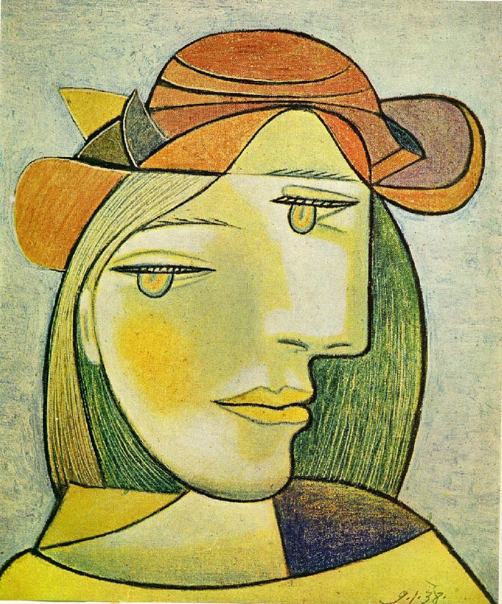
A B

Slide 6
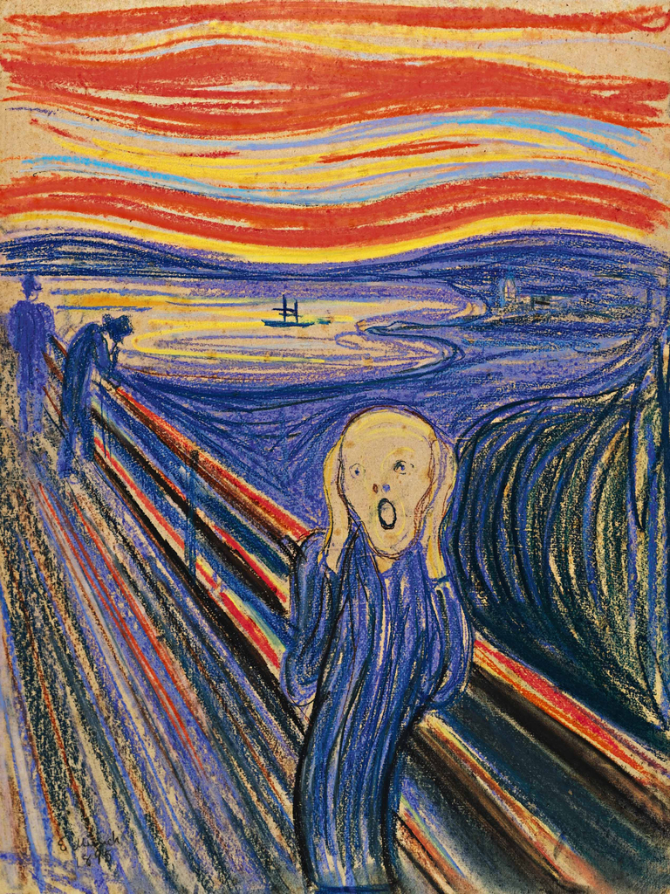
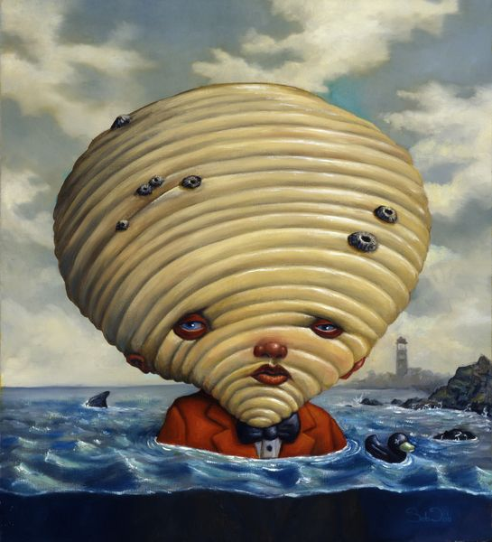
A B

Slide 7
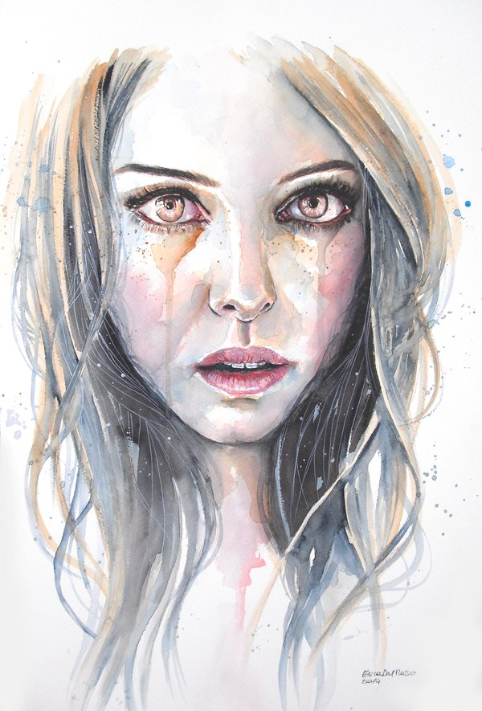
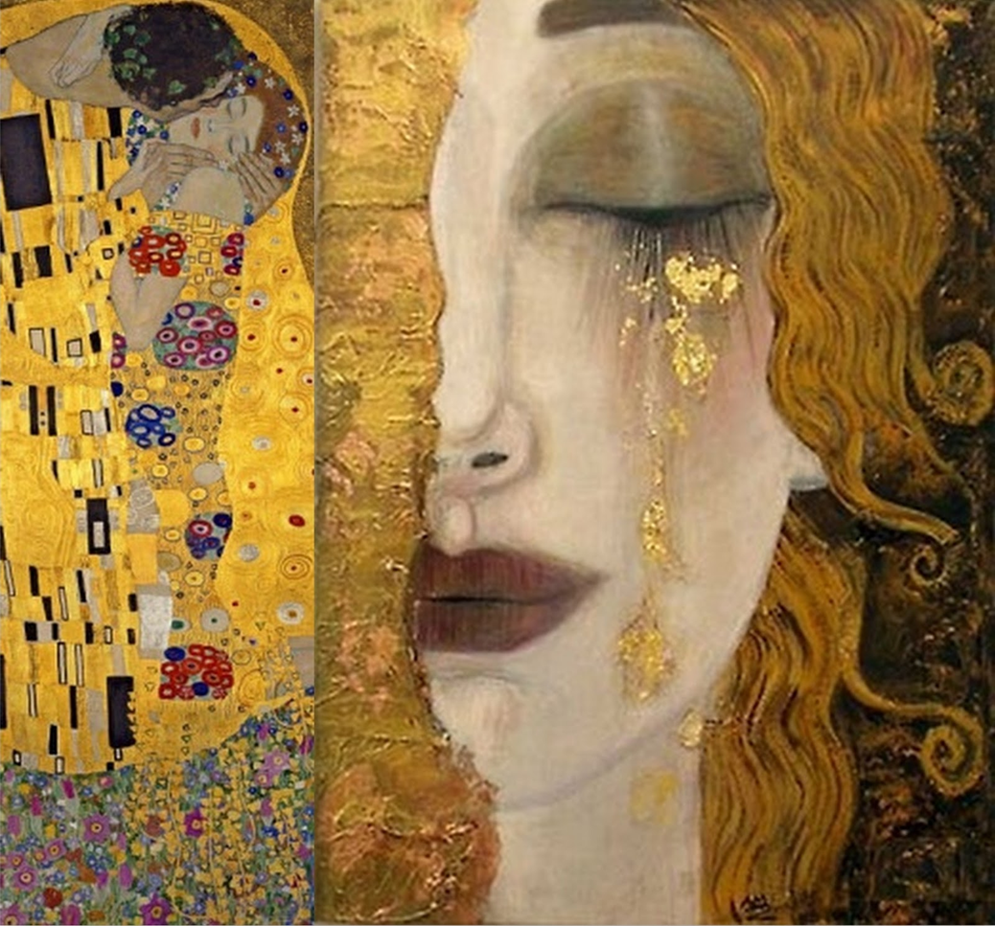
A B

Slide 8
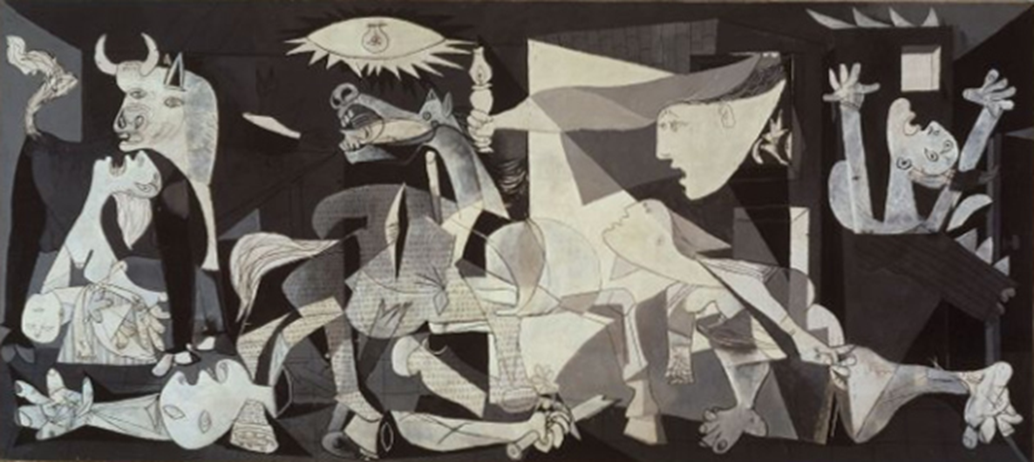
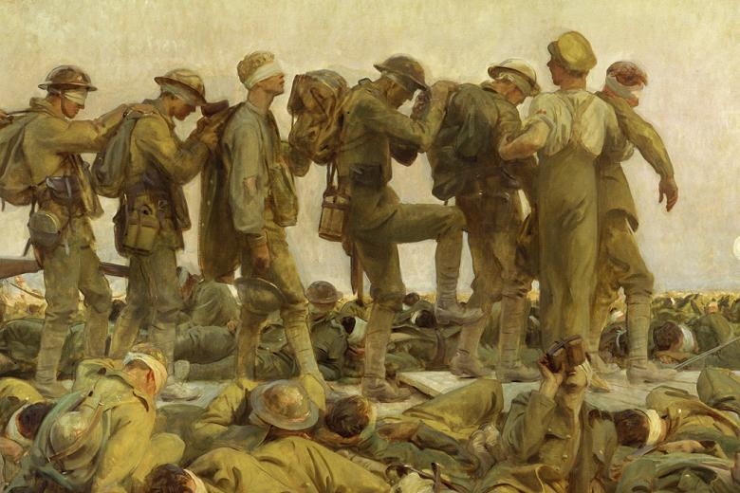
A
B
B

Slide 9
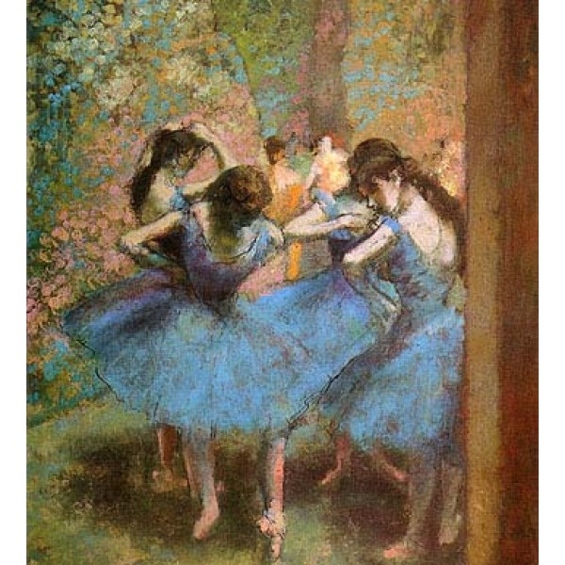
A B

Slide 10
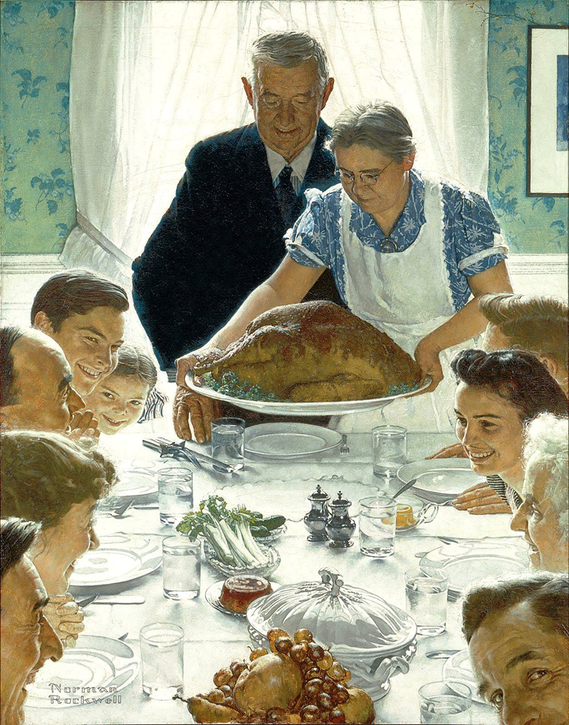
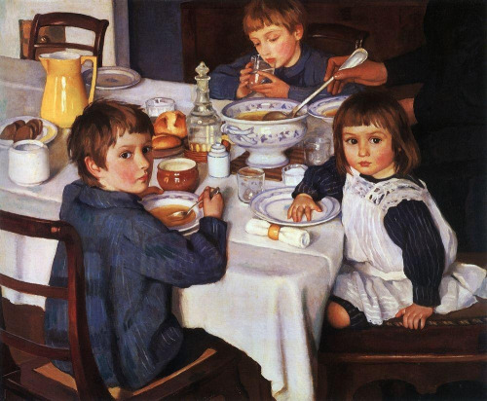
A B

Slide 11
Vocabulary practice
This old woman looks nice. She reminds me of my great grandmother. She seems ____________. She is also ________ to be a model for the first time in her life. I wouldn't like to have this painting in my house, because she has a __________ look in her eyes.
content
spooky
proud

Slide 12
agony
shocked
surprised
self conscious
He saw the sea for the first time and is __________ by the sheer size of it. He namely lost something in the ocean and is now in ____________, because it is lost forever. Or he is _____________ that the sunset is so beautiful. He is ________________, because his head is so big.

Slide 13
Complete the words
astated
enjoying
perate
pair
There is a guy cheating on her, so she is des__________ and dev_____________. However, she looks pretty in her des______________. The girl on the left is _______________ herself.

Slide 14
strange
ordinary
disturbing
It‘s a picture of a woman, but it‘s not an ___________ woman. There‘s a strange woman. Her face is laid out in an unusual manner. She‘s wearing a hat. The colours are ___________, not the normal colours of skin. It‘s quite ______________, quite strange, quite i__________________.
ntriguing

Slide 15
INTERACTIVE STORY
True story. Decide which part is true:
A – stand up
B – touch your nose
C – raise your hand

Slide 16
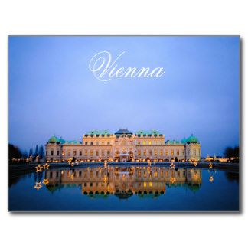
Last Christmas my family and I decided to take a short trip. I wanted this trip to be a cultural event. So we decided to go to one European capital. We went to:
A – Paris
B – Vienna
C – Barcelona

Slide 17
Since Vienna is rather close to where we live, we went by car. But the car is not a favourite way of transport for our two girls. During a long journey they are usually:
A – annoying, because they fight and nag and keep asking if we are there yet.
B – pleasant, because they sleep
C – messy, because they eat in the car
A – nag, fight

Slide 18
Once we arrive to the centre of Vienna, we had to park the car. When my husband saw this sign, he said perfect. What did he see:
A – free parking sign
B – a parking near a steak house
C – a parking lot in front of an opera house

Slide 19
In Vienna we wanted to show the girls The Opera house, the Hofburg – the royal palace and the Christmas market in the park. But as we were passing a gallery called Albertina, we decided to go in there first. Why:
A –the entry for children was free
B – we saw a family we recognised
C – they had works of Picasso, Munch and Van Gogh

Slide 20
The gallery is a beautiful building with a lot of famous works of art and already in the lobby I started motivating the girls for art, especially when we saw they have „The Scream by Munch“. After that the girls were:
A – annoying, because they were bored and hungry
B – worrying, because they were running around and might knock something down
C – interested in art
C – contrary to my expectations

Slide 21
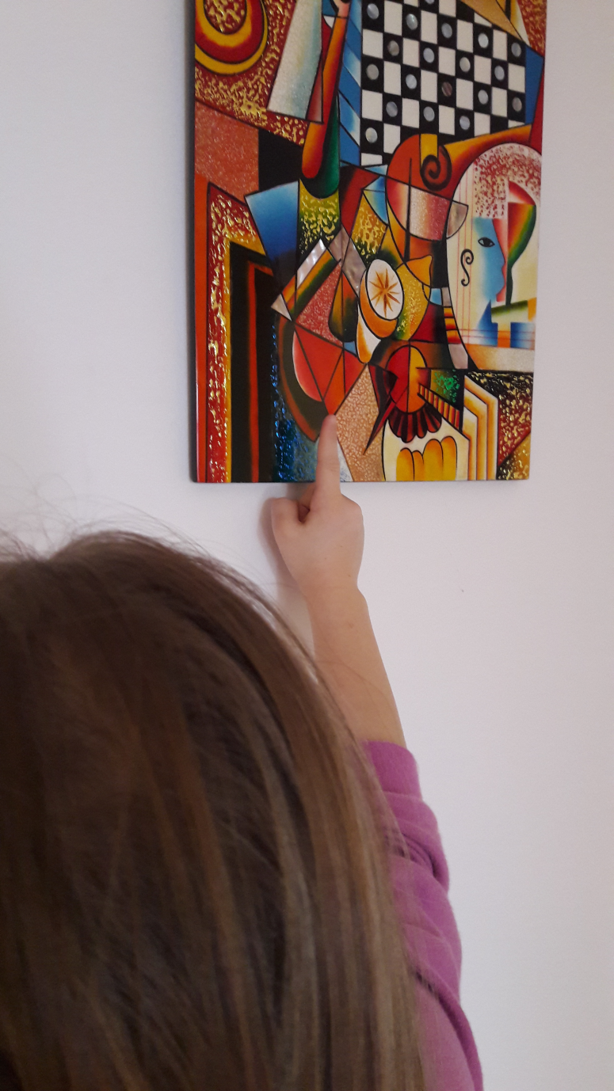
We saw the works of Munch, Picasso, Degas and other impressionists and the girls were simply amazing, until something unthinkable happened:
A – The fire alarm went on and we had to leave the building
B – one of the girls touched a painting and was spotted by the security guard
C – one of the girls got sick

Slide 22
Immediattely the whole hell started. The security guard started warning her and called the curator to assess the damage and they also took our personal IDs and said we might have to pay for the damage. The security guard said this painting is worth 60.000 euro. I haven‘t got that kind of money.

Slide 23
Imagine the scene.
The girl was crying. She was humiliated and devastated.
The father was angry, furiuous with the guard and the gallery, because they didn‘t have the painting under a glass or protected in any way
The mother was disapointed in the child, because she should know better.

Slide 24
MODELLING
Choose one character and model that emotion in clay. Choose the right colour / texture / shape for your emotion.

