Slide 3
EMOTIONS 2 part 1

Slide 4
DECISIONS
A – raise your hand
B – touch your nose

Slide 5
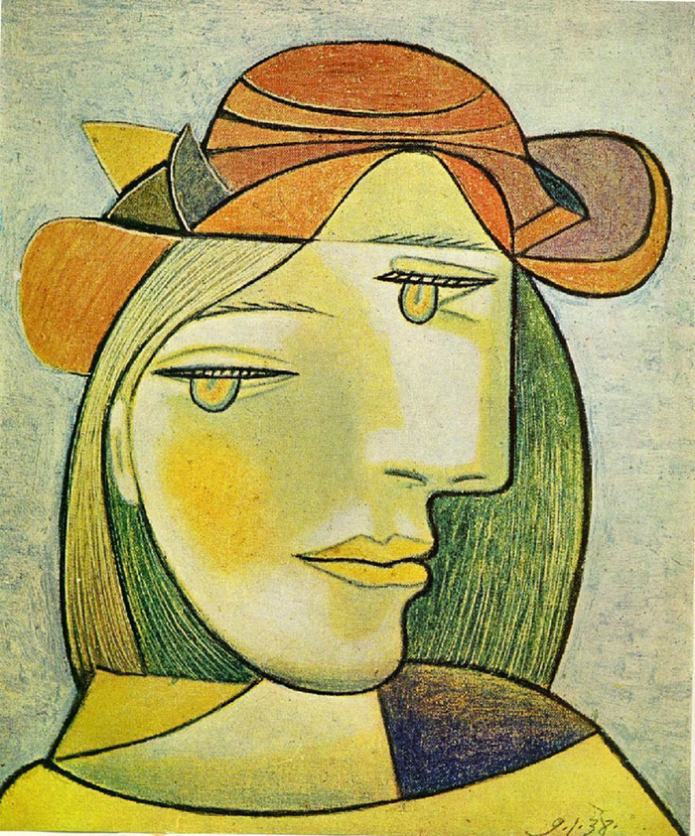
A B

Slide 6
A woman wearing hat by Pablo Picasso

Slide 7
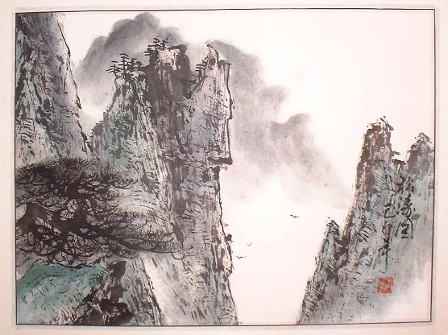
A B

Slide 8
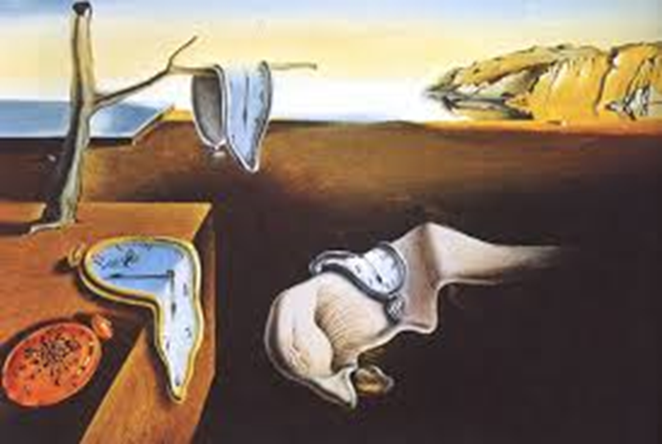
The persistence of memory by Salvador Dali

Slide 9
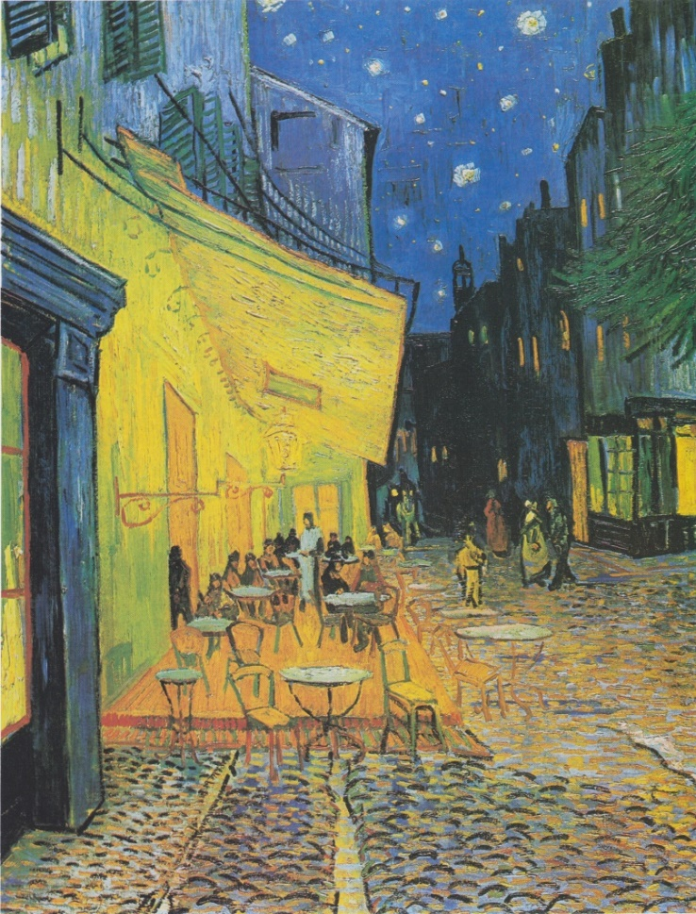
A B

Slide 10
The Cafe Terrace on the Place du Forum by Vincent van Gogh

Slide 11
A B

Slide 12
Banana by Andy Warhol

Slide 14
DECISIONS 2
A – STAND UP
B – RAISE YOUR HAND

