Slide 2
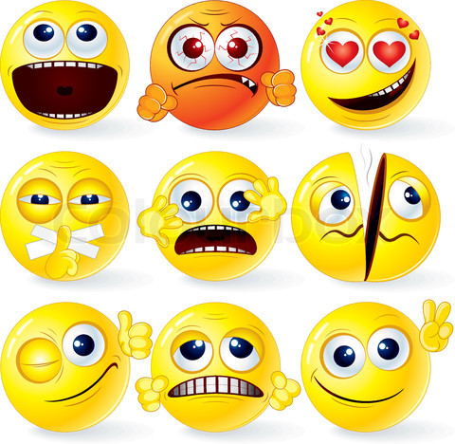
emotions

Slide 4
How do you feel when:
You have to write a test?
You hear about a tragedy?
You see somebody you like?
You are on holidays?
Your parents don‘t allow you to go out?
When you have to write a test you didn‘t learn for?

Slide 5
find synonyms
EMOTION | SYNONYM
NERVOUS
SAD
IN LOVE
HAPPY
RELAXED
ANGRY
WORRIED

Slide 6
Hot potatoes exercises

Slide 7
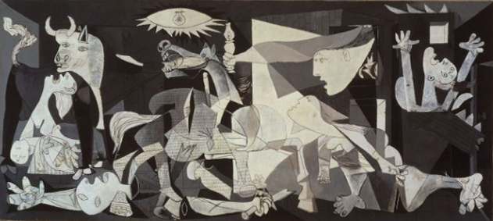
how do you feel looking at these works of art?

Slide 8
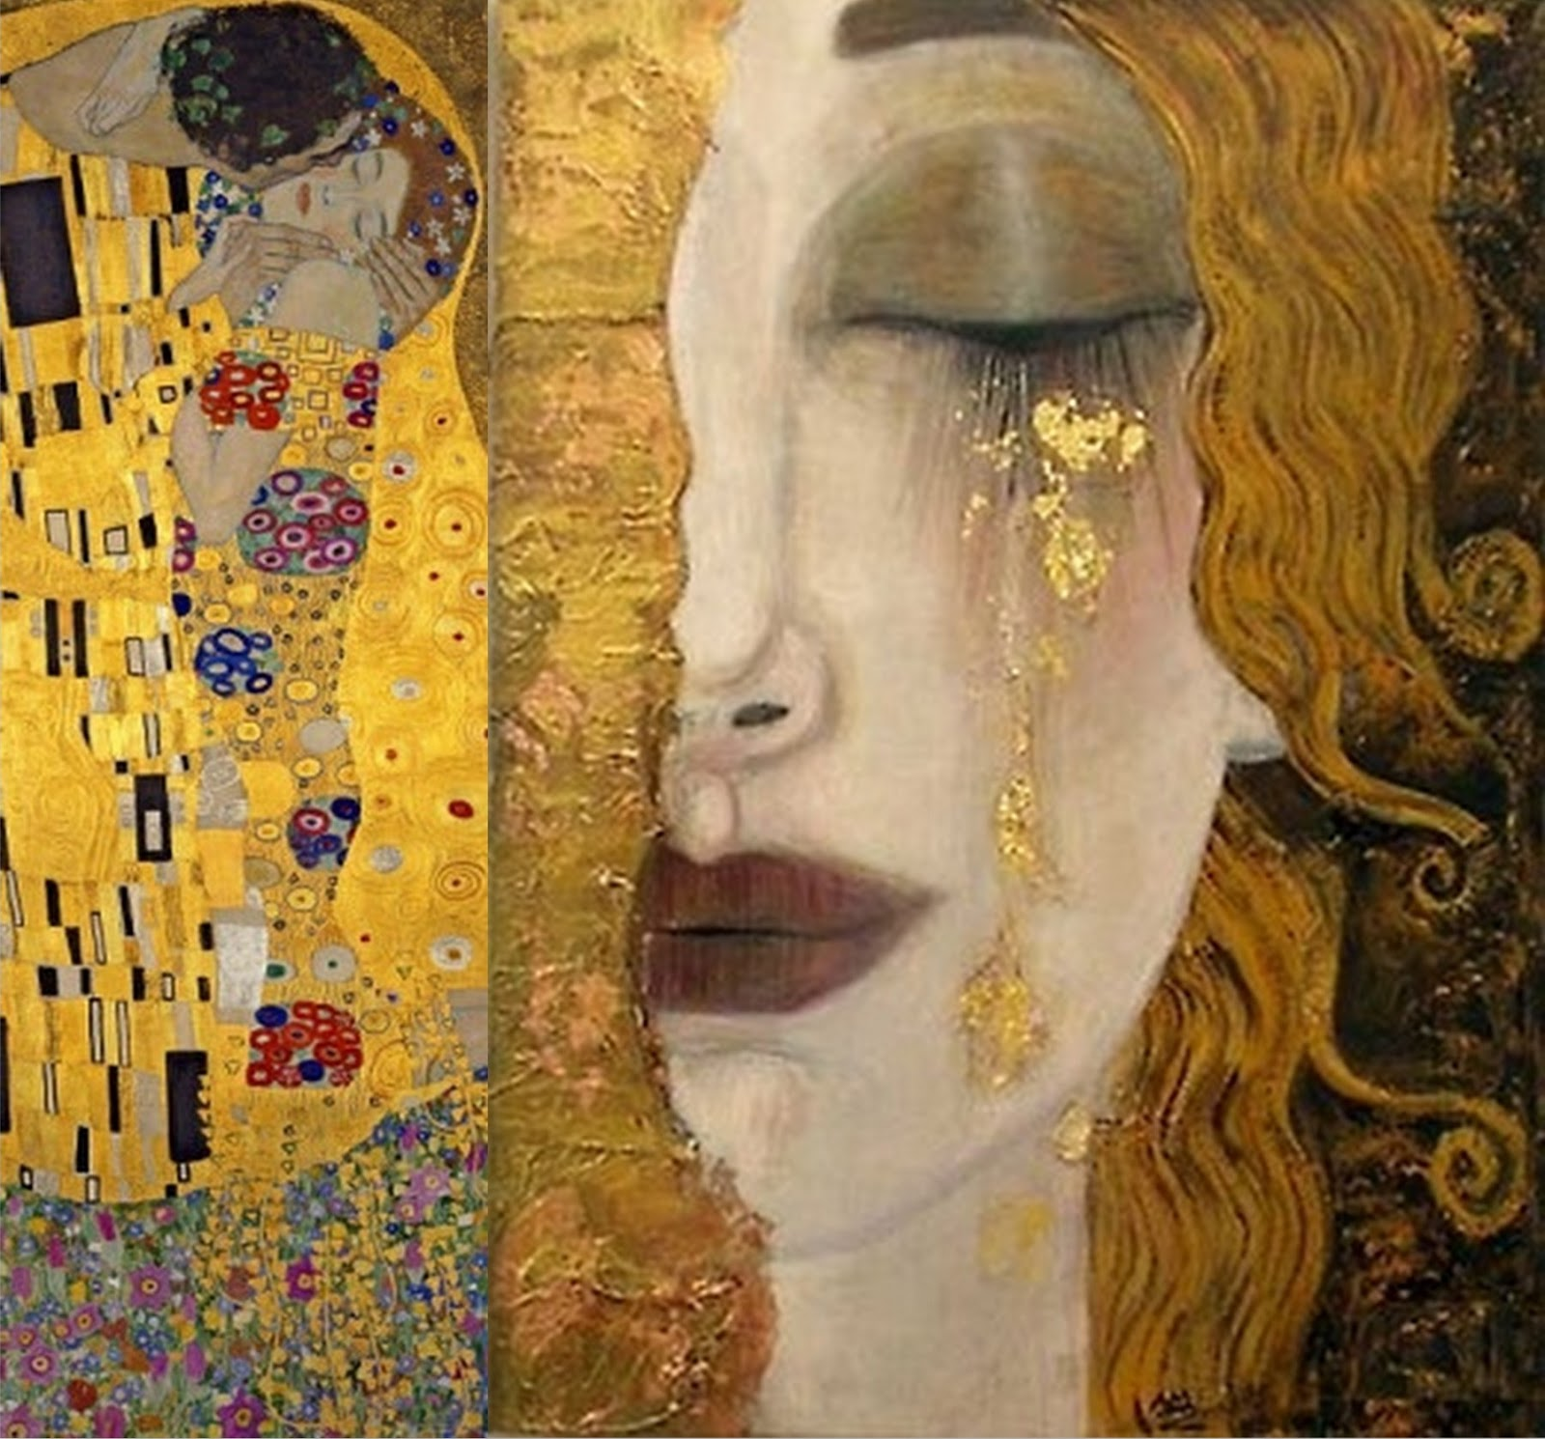

Slide 9
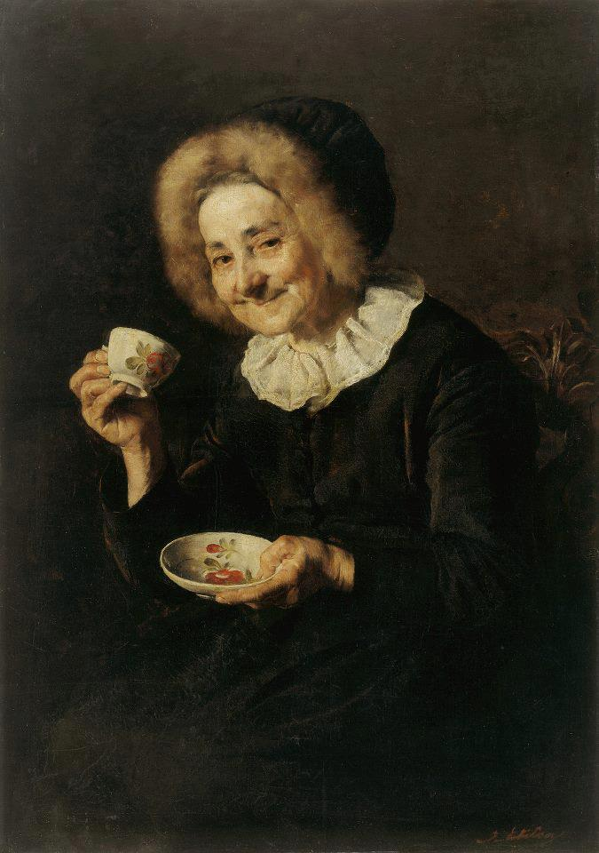

Slide 10
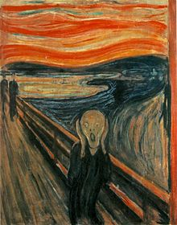

Slide 12
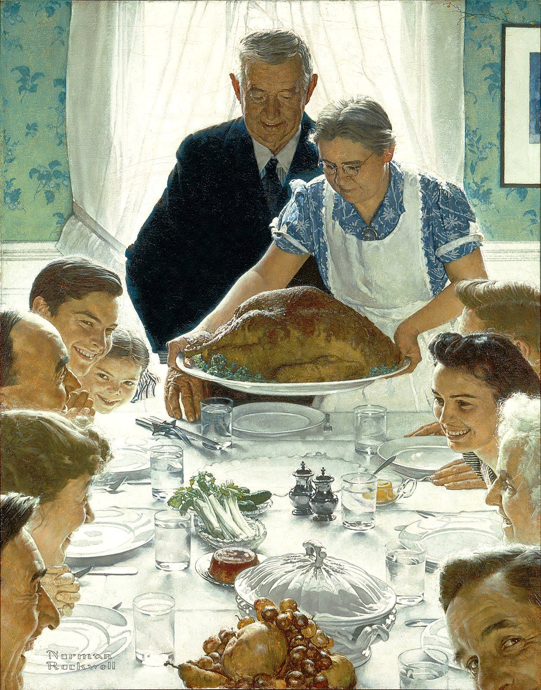

Slide 13
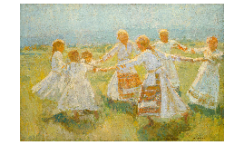

Slide 14
Look again

Slide 15
how do charcters in the paintings feel?
Guernica by Pablo Picasso

Slide 16
Dance (kolo) by Matija Jama

Slide 17
Scream by
Edward Munch

Slide 18
Kofetarica by
Ivana Kobilica

Slide 19
Kiss by
Gustav Klimt

Slide 20
Birth of Venus by
Sandro Botticelli

Slide 21
Thanksgiving day
by Norman Rockwell

Slide 22
Group work
You have 5 minutes!
Four students will come and take a card. Then you will select other students available in the class to help you. In some cases one is enough!
Try to act out the scene in the painting!
How do/es the character/s feel? Do you feel the same way or different?
Report!
Scooby doo and I acted out the scene from The dance. The ladies there feel joyful, and / but I felt ….

Slide 23
Listening – which painting is it about?
Klimt
Picasso
Jama
Kobilica
Rockwell
Munch

Slide 24
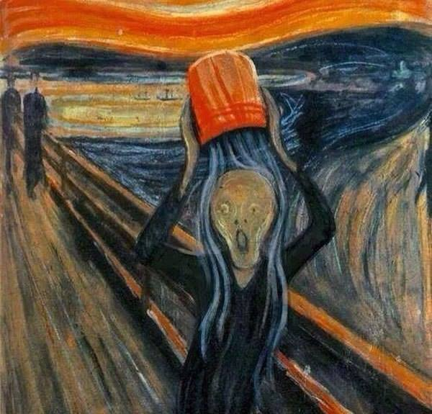
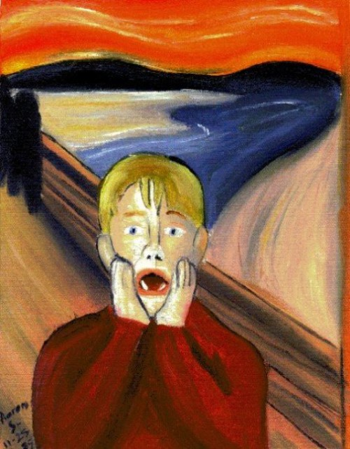
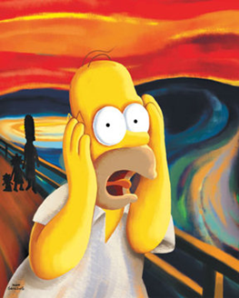
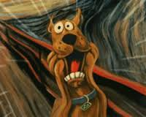
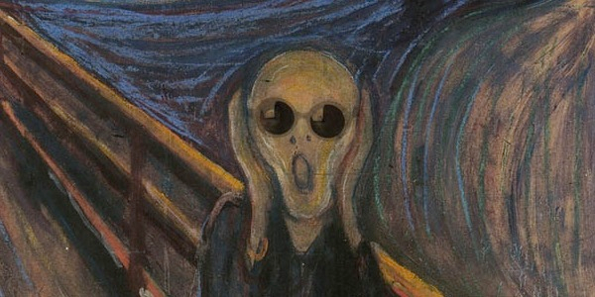
Do you recognize the characters?

Slide 25
How are they feeling and why? Make a quote!

Slide 26
Which painting?
When I'm depressed I cry,
when I'm happy I smile,
when I'm tired I just fall asleep.
When I'm anxsious I clean,
when I'm afraid I grit my teeth,
when I'm serene, I drink some coffee.

Slide 27
Read
IN A JOYFUL VOICE
IN A SHY VOICE
IN A DEPRESSED VOICE
When I'm depressed I cry,
when I'm happy I smile,
when I'm tired I just fall asleep.
When I'm anxsious I clean,
when I'm afraid I grit my teeth,
when I'm serene, I drink some coffee.
Open the document with the poem and change the emotions – instead of depressed, nervous…
Find the emotions

Slide 28
Check – you can‘t have the emotions in red
When I'm depressed I cry,
when I'm happy I smile,
when I'm tired I just fall asleep.
When I'm anxsious I clean,
when I'm afraid I grit my teeth,
when I'm serene, I drink some coffee.
Find the activities
change the activities

Slide 29
Read your poem

