Slide 1
Through geography
about feelings

Slide 2
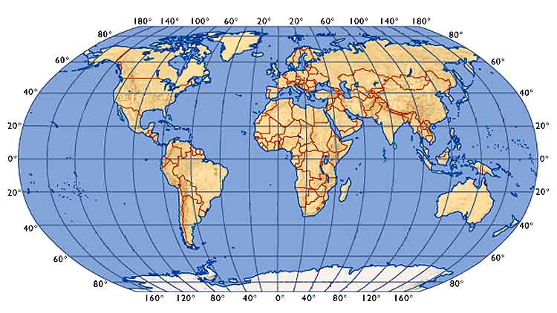
www.educa.fmf.uni-lj.si
Earth.
Oceans.
Continents.

Slide 3
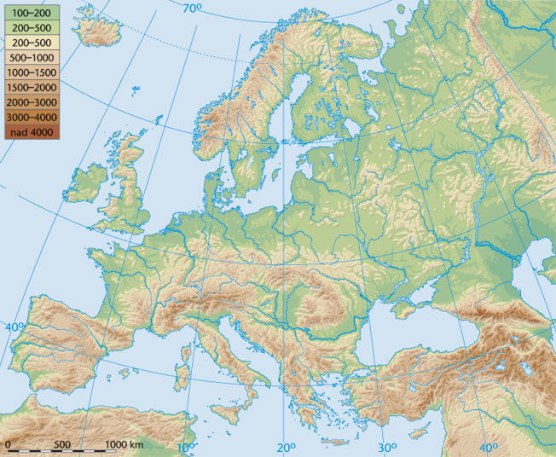
http://www.modrijan.si
Countries
(states).

Slide 4
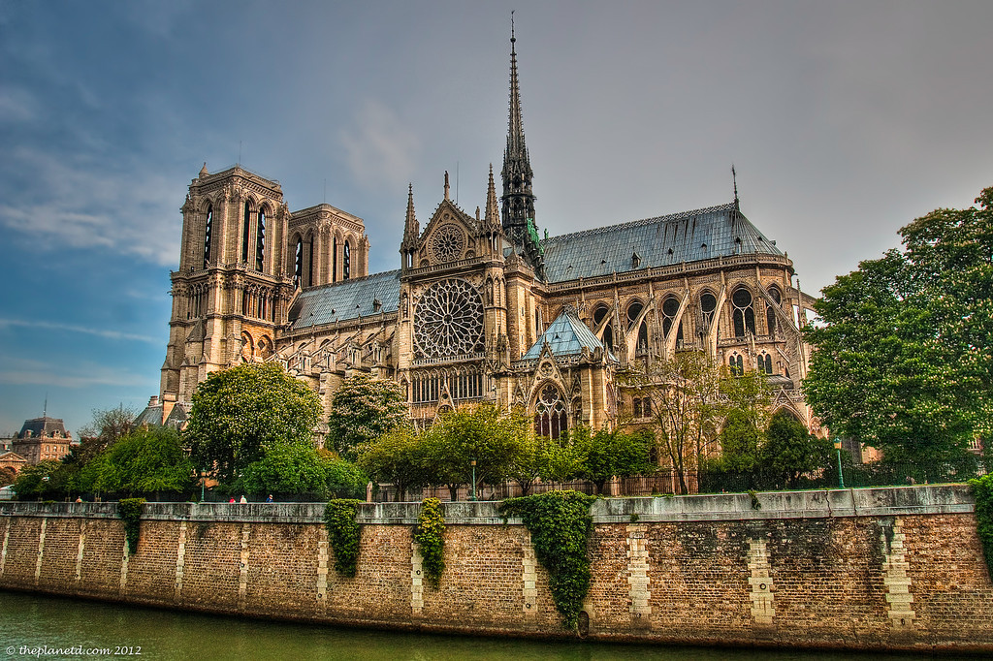
TravelDigg.com
http://traveldigg.com/
https://www.flickr.com/photos/opzjon/11232274605
http://traveldigg.com

Slide 5
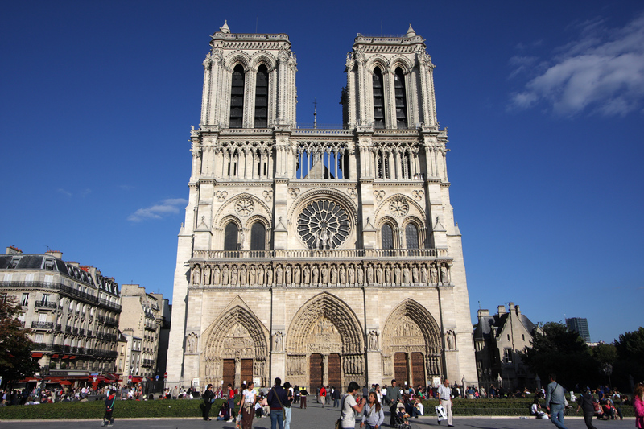
TravelDigg.com
http://traveldigg.com/
http://www.sacred-destinations.com/

Slide 6
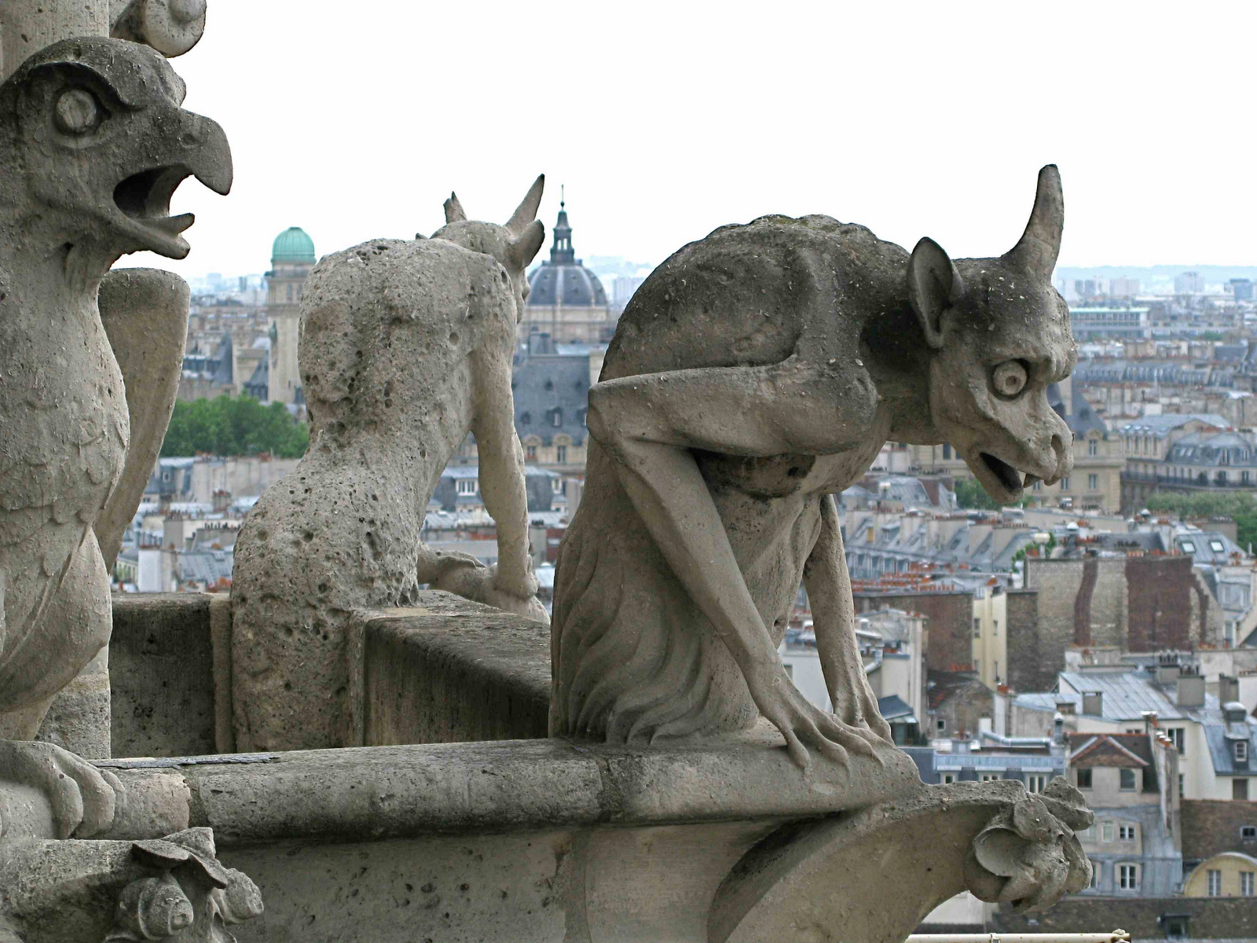

TravelDigg.com
http://traveldigg.com/
http://www.sacred-destinations.com/
www.pinterest.com
http://traveldigg.com

Slide 7
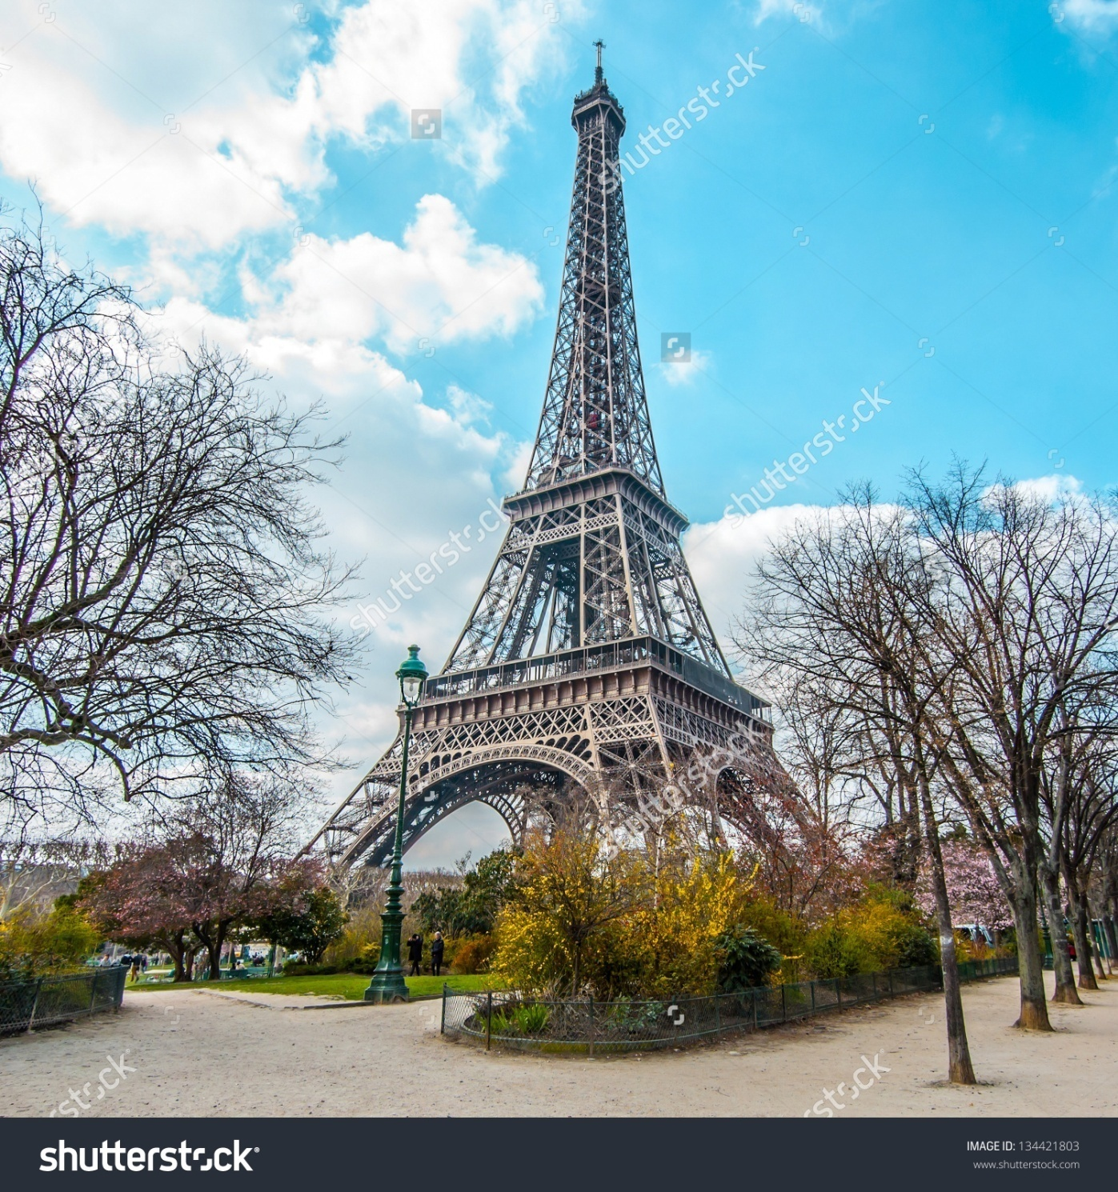
http://www.toureiffel.paris/360-panorama-paris/index-en.html

Slide 8
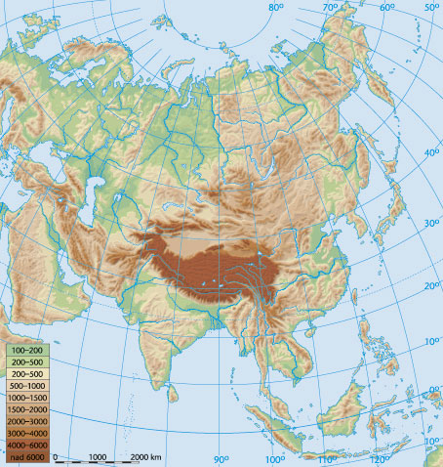
Countries
(states).
http://www.modrijan.si
Native people

Slide 9
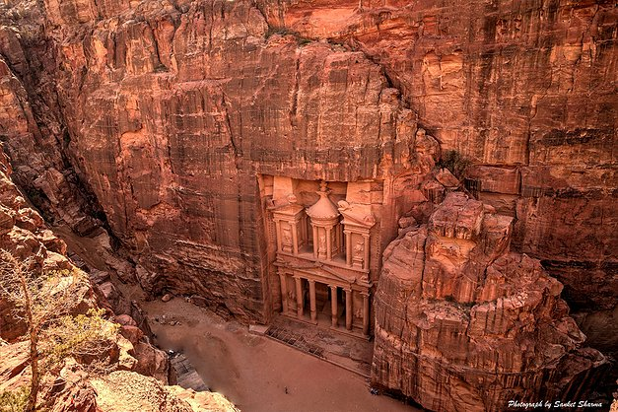
www.sanketsharma.com
www.youtube.com/watch?v=5bUeWStgeTY
https://www.youtube.com/watch?v=8oj7ZR673MY

Slide 10
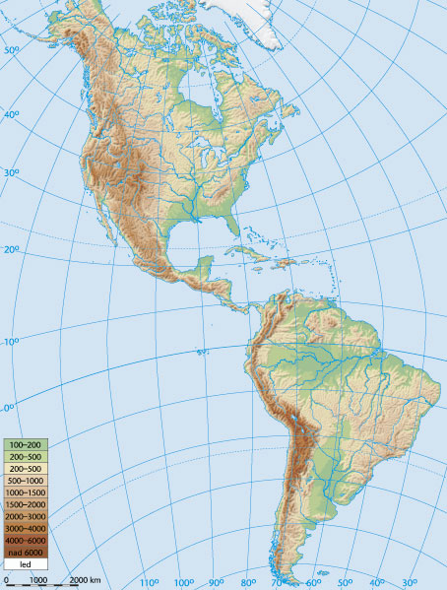
Countries
(states).
http://www.modrijan.si
Native people

Slide 11
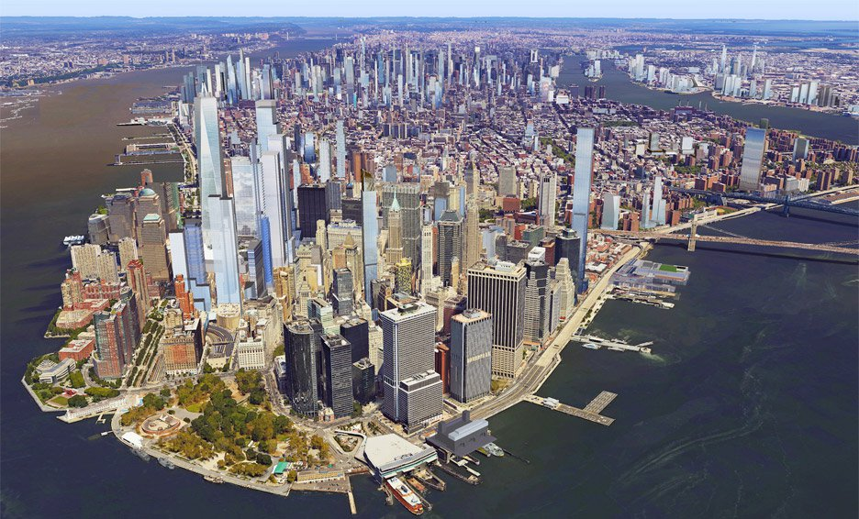
www.dezeen.com

Slide 12
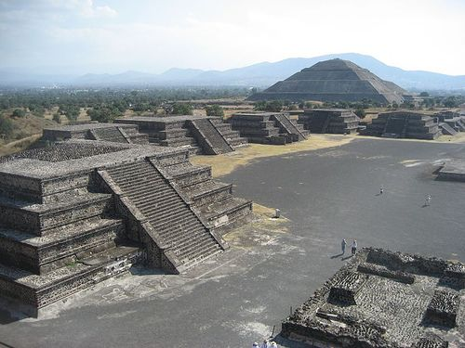
https://s-media-cache-ak0.pinimg.com/564x/fc/e7/f1/fce7f17fcb4fc726734e71085576ecb6.jpg

Slide 13
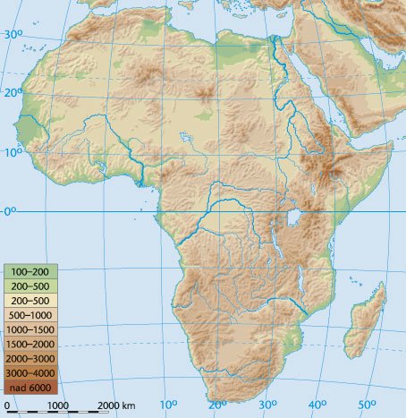
Countrys
(states).
http://www.modrijan.si
Native people

Slide 14
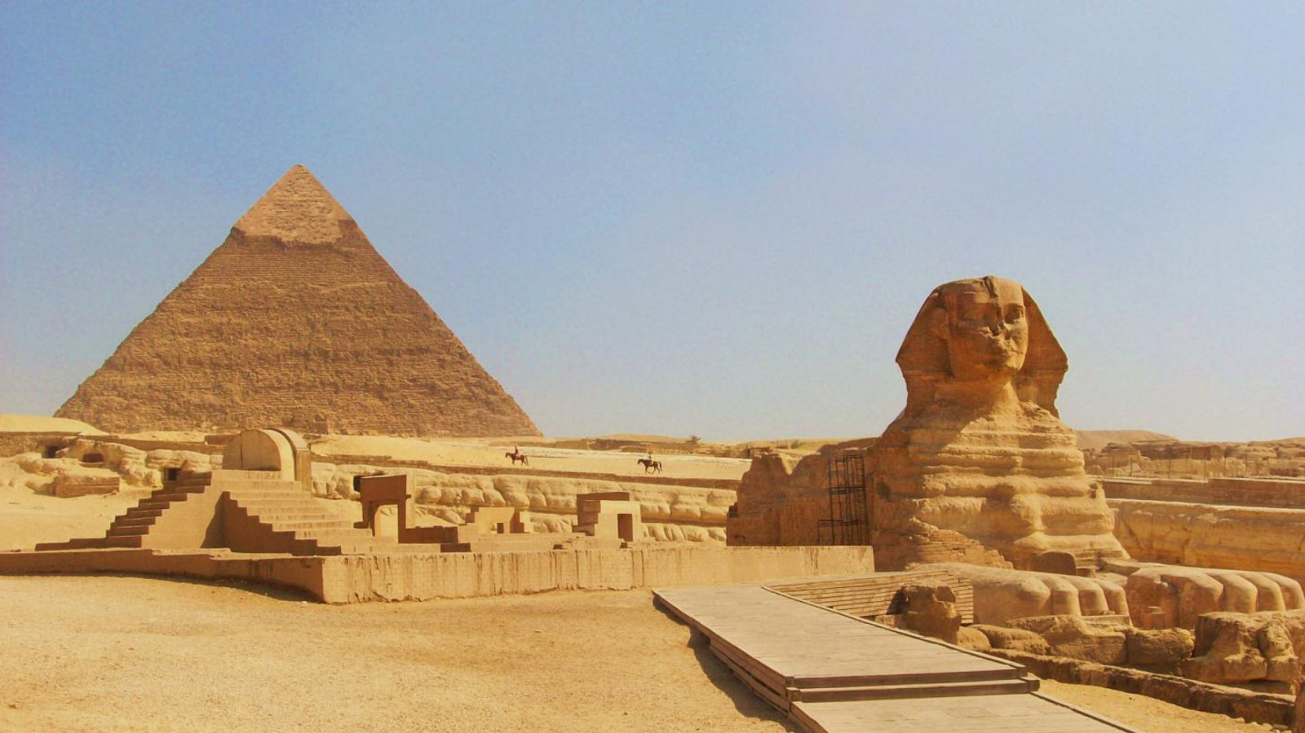
Through geography
about feelings
Egypttoursgate.com

Slide 15
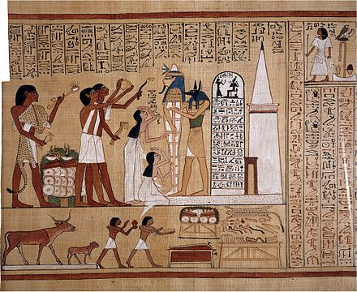
es.wikipedia.org

Slide 16
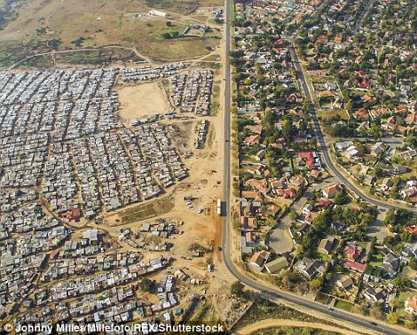
http://www.dailymail.co.uk/travel/travel_news/article-3654070/See-extreme-divide-rich-poor-South-Africa.html

Slide 17
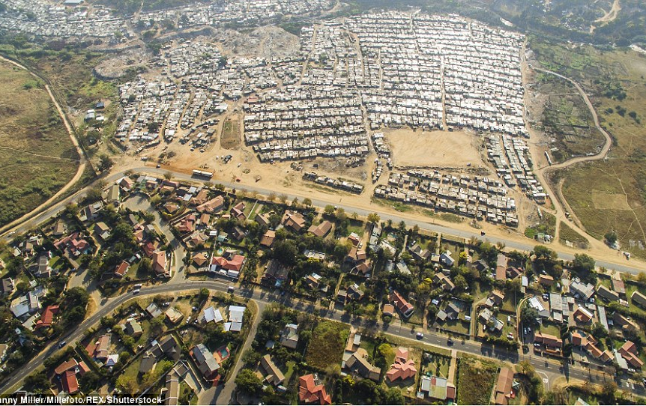
http://www.dailymail.co.uk/travel/travel_news/article-3654070/See-extreme-divide-rich-poor-South-Africa.html

Slide 18
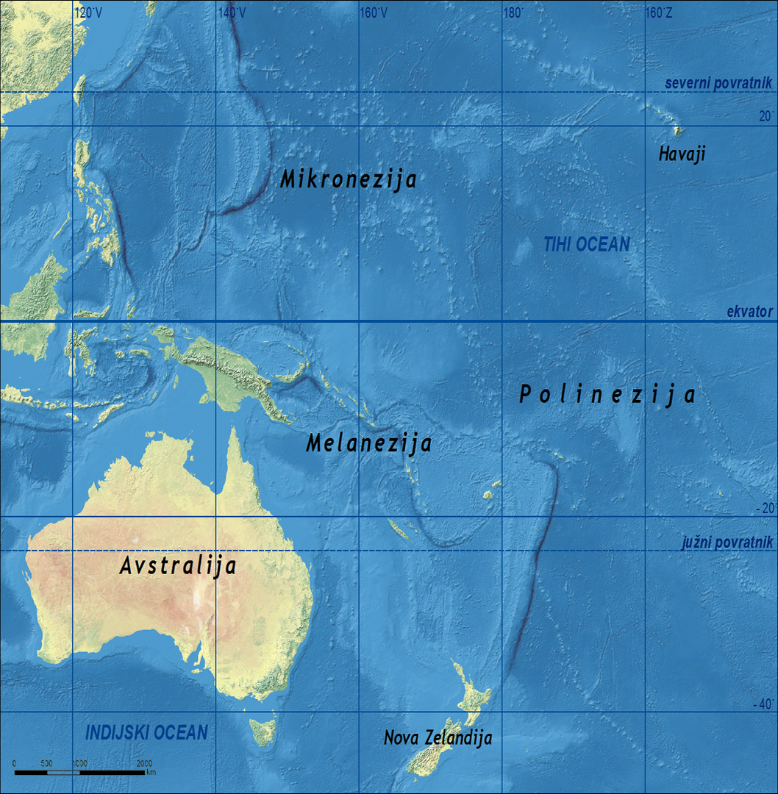
eucbeniki.sio.si
Native
people

Slide 19
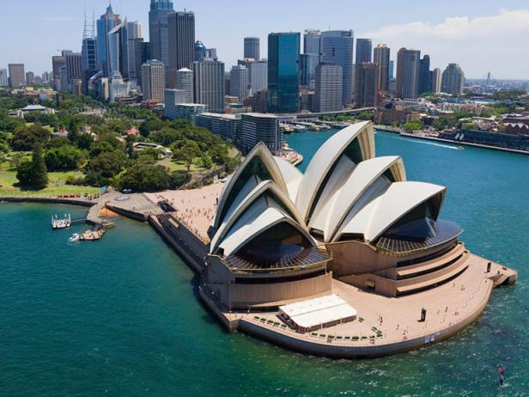
Travel Channel
Travel Channel

Slide 20
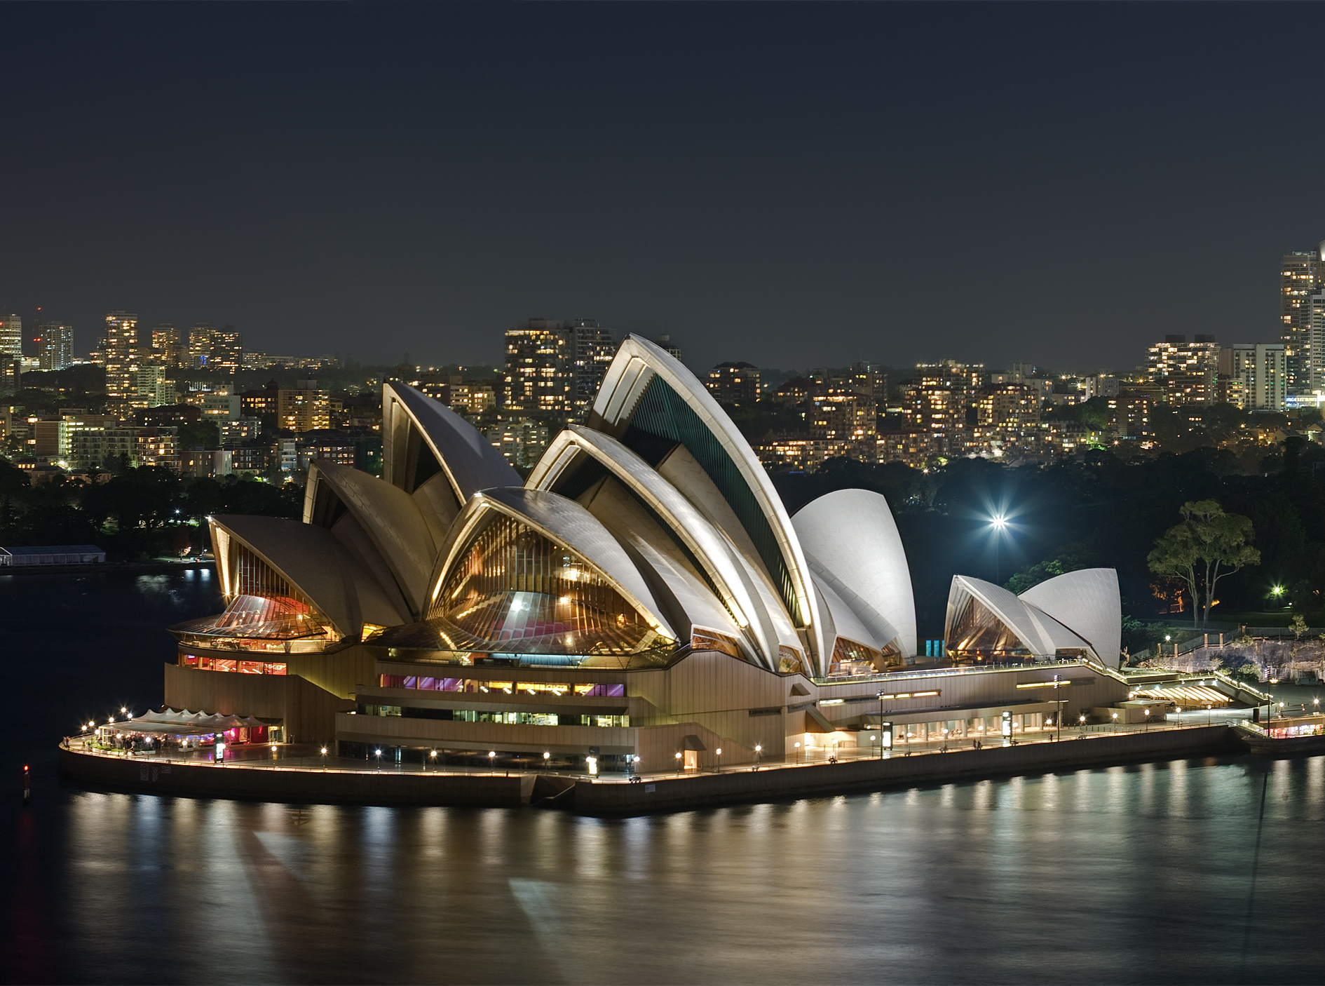
Travel Channel
Wikipedia

Slide 21
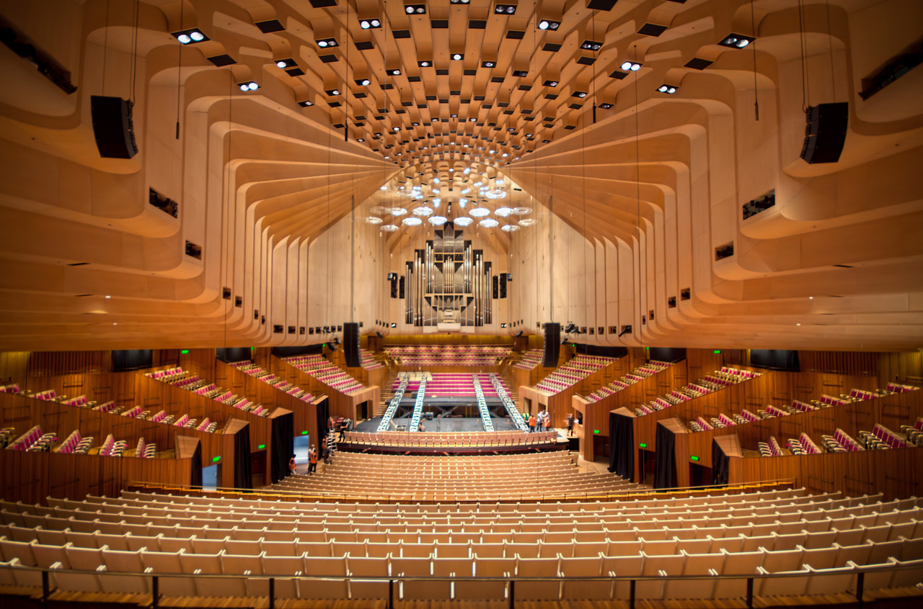
Reddit

Slide 22
Through geography
about feelings
Feelings through architecture

