Slide 1


Slide 2

SENSES elementary
Lesson 4
Slovenia
Teacher : Andreja Žalik Kranjec

Slide 3
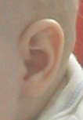
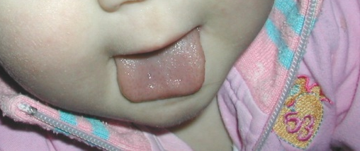
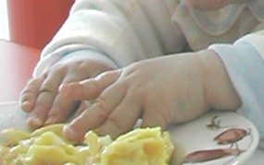
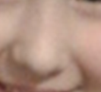
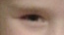
What senses have we got?
    HEAR
    FEEL
    SMELL
    SEE
TASTE

Slide 4
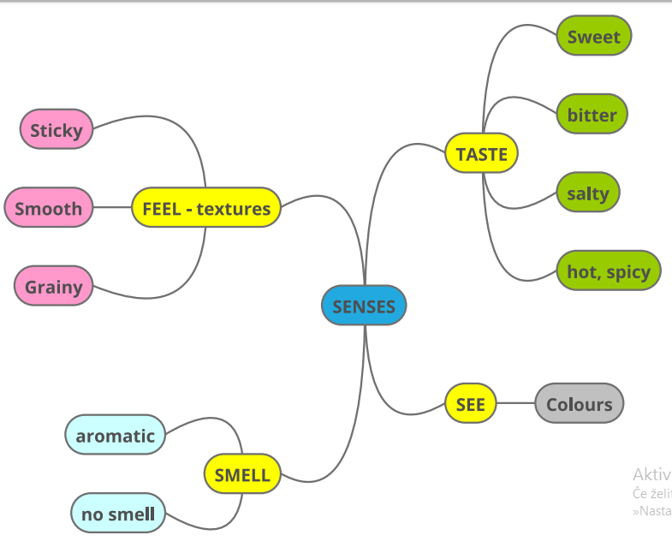

Slide 5
SENSES – handout ex.1
Complete the map and translate the words.
Which sense is not in the diagram?
Which taste is not in the diagram?
HEAR
SOUR

Slide 6

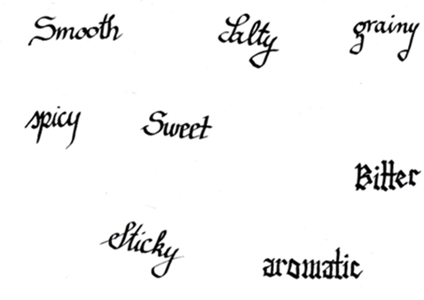
Give examples of which are:

Slide 7
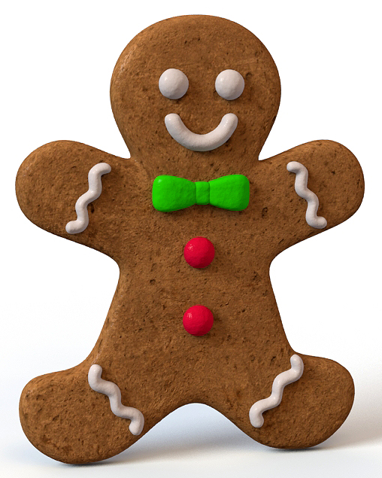
Sometimes, especially at Christmas we make gingerbread biscuits . We need:
  Flour
  Sugar
  Cocoa powder
  Butter
  Honey
  Cinnamon
  salt

Slide 8

Handout ex. 2
At the back of the classroom are food items we use to make gingerbread biscuits from. Use your handout and all your senses to fill in the charts.
If you are allergic to any of these, please do not taste!
You have 5 minutes

Slide 9
Handout ex. 3
PREPARE TO REPORT
Vanilla sugar is grainy and it is aromatic. It tastes sweet. It is white.
Salt is not aromatic.
Flour does not have a taste.

Slide 10
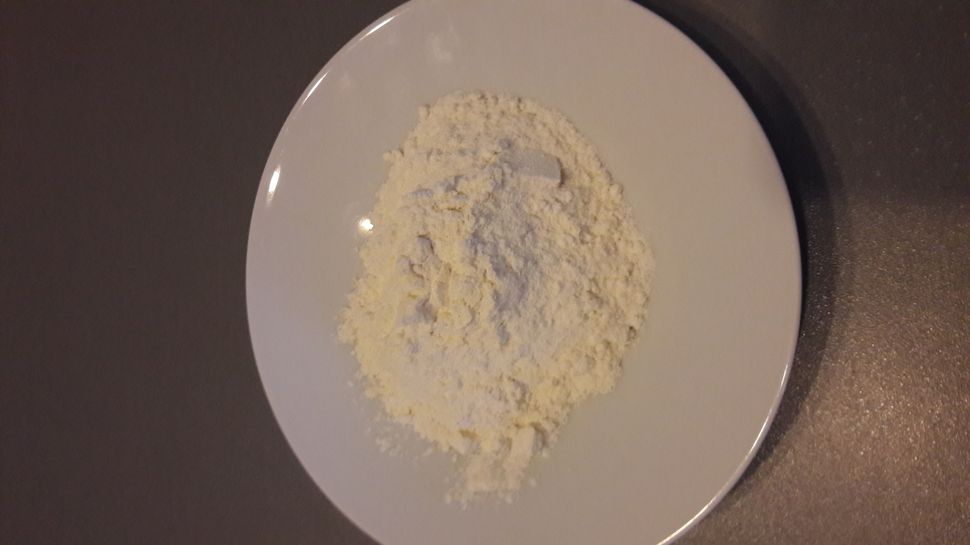
What do you now know about…
flour

Slide 11
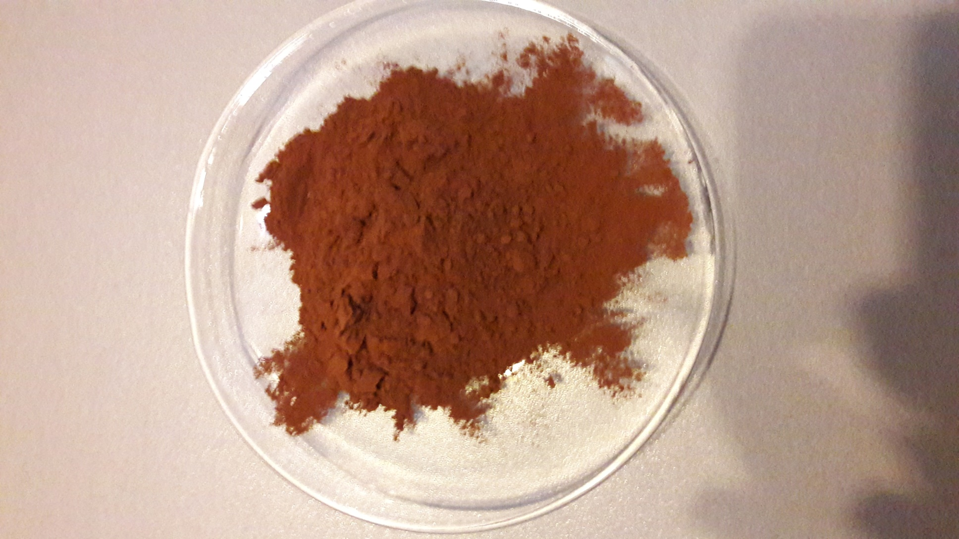
What do you now know about…
Cocoa powder

Slide 12
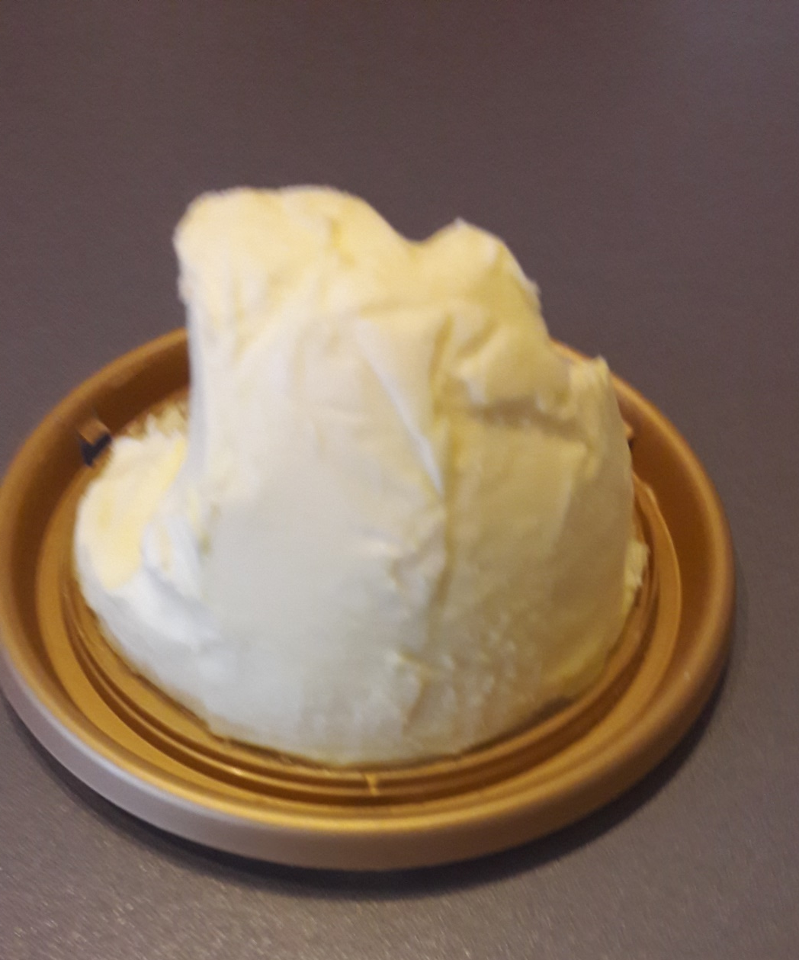
What do you now know about…
butter

Slide 13
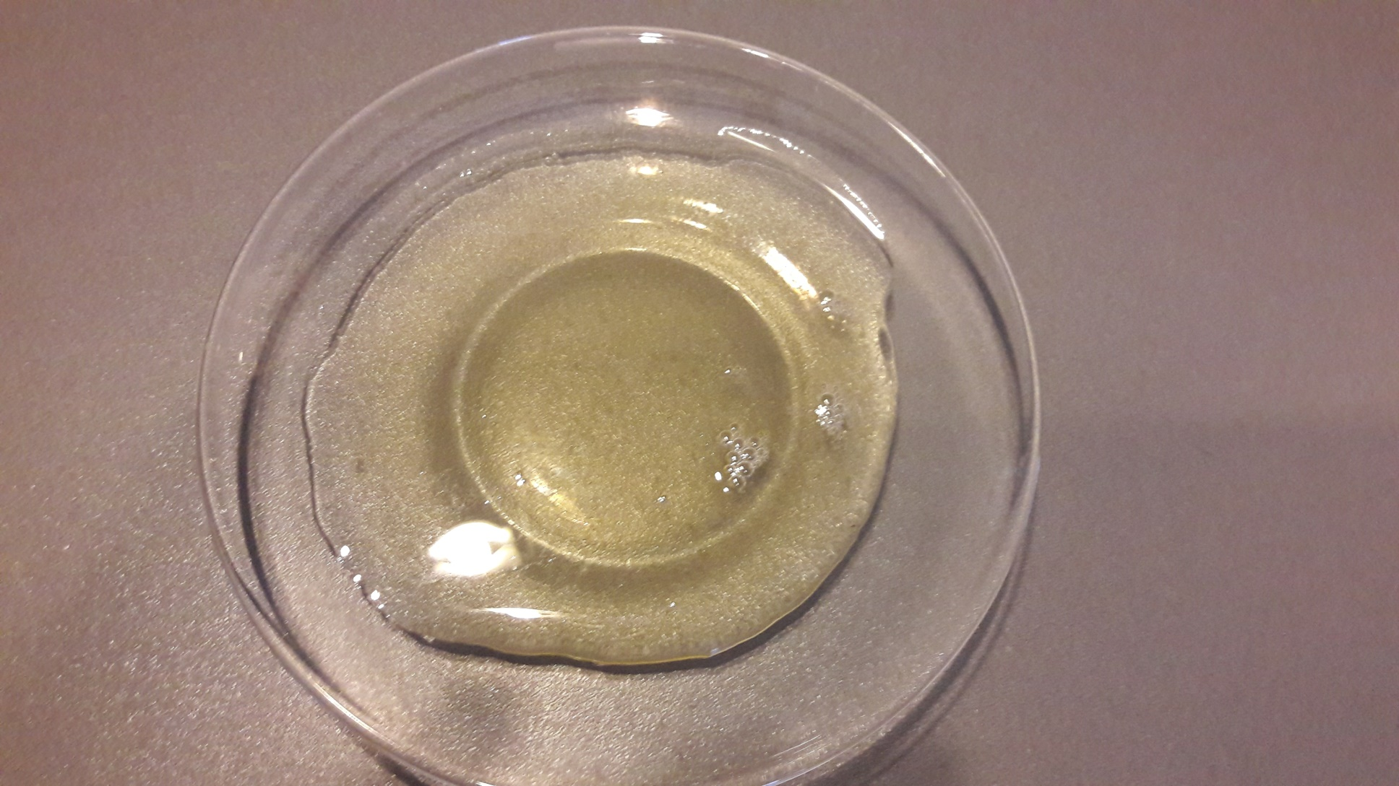
honey

Slide 14
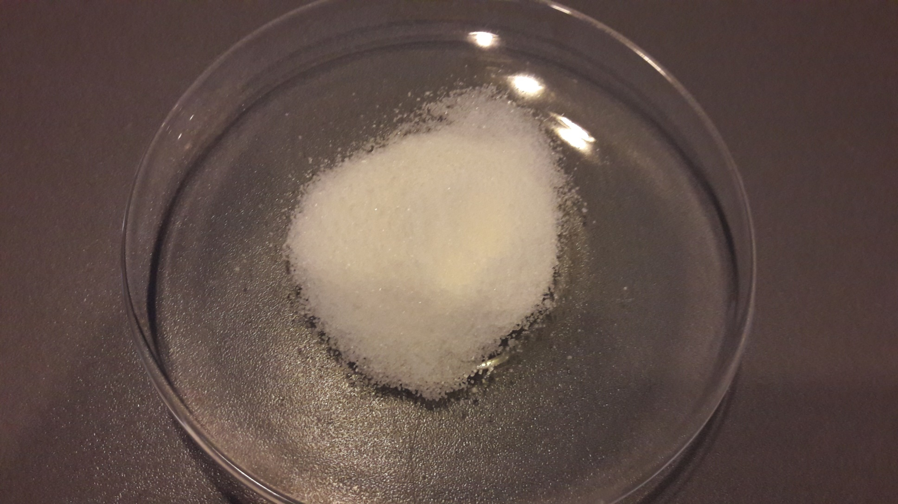
Vanilla sugar

Slide 15
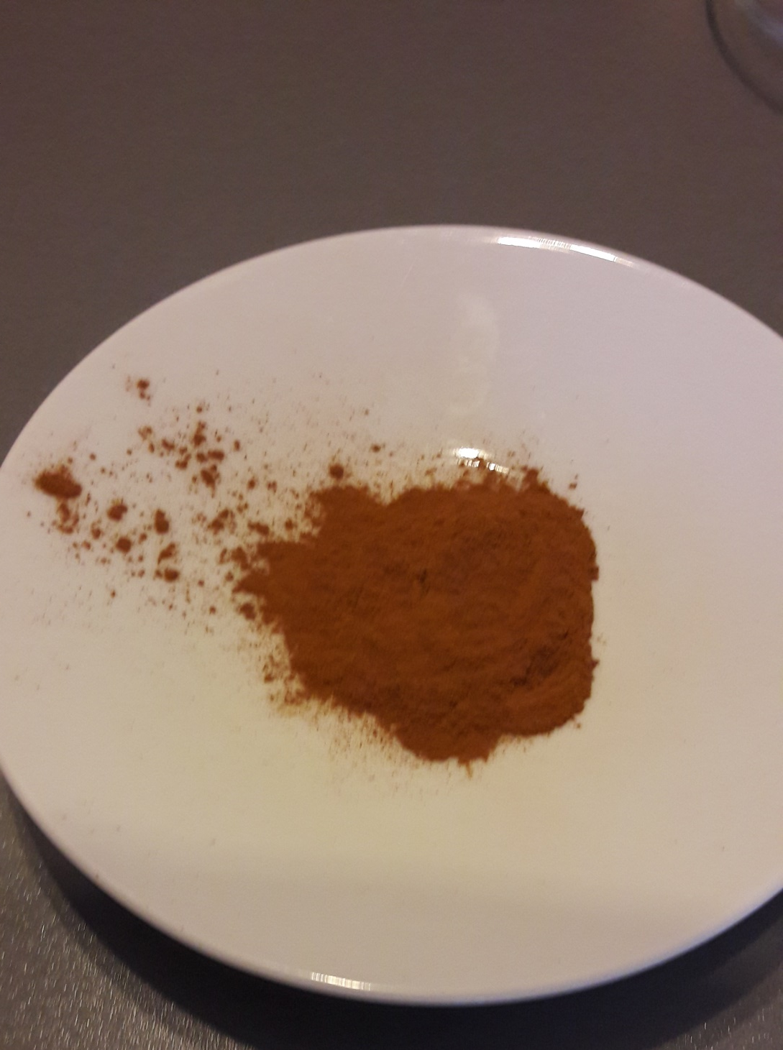
cinnamon
Did you notice that cinnamon tastes sweet, but also a bit hot?

Slide 16
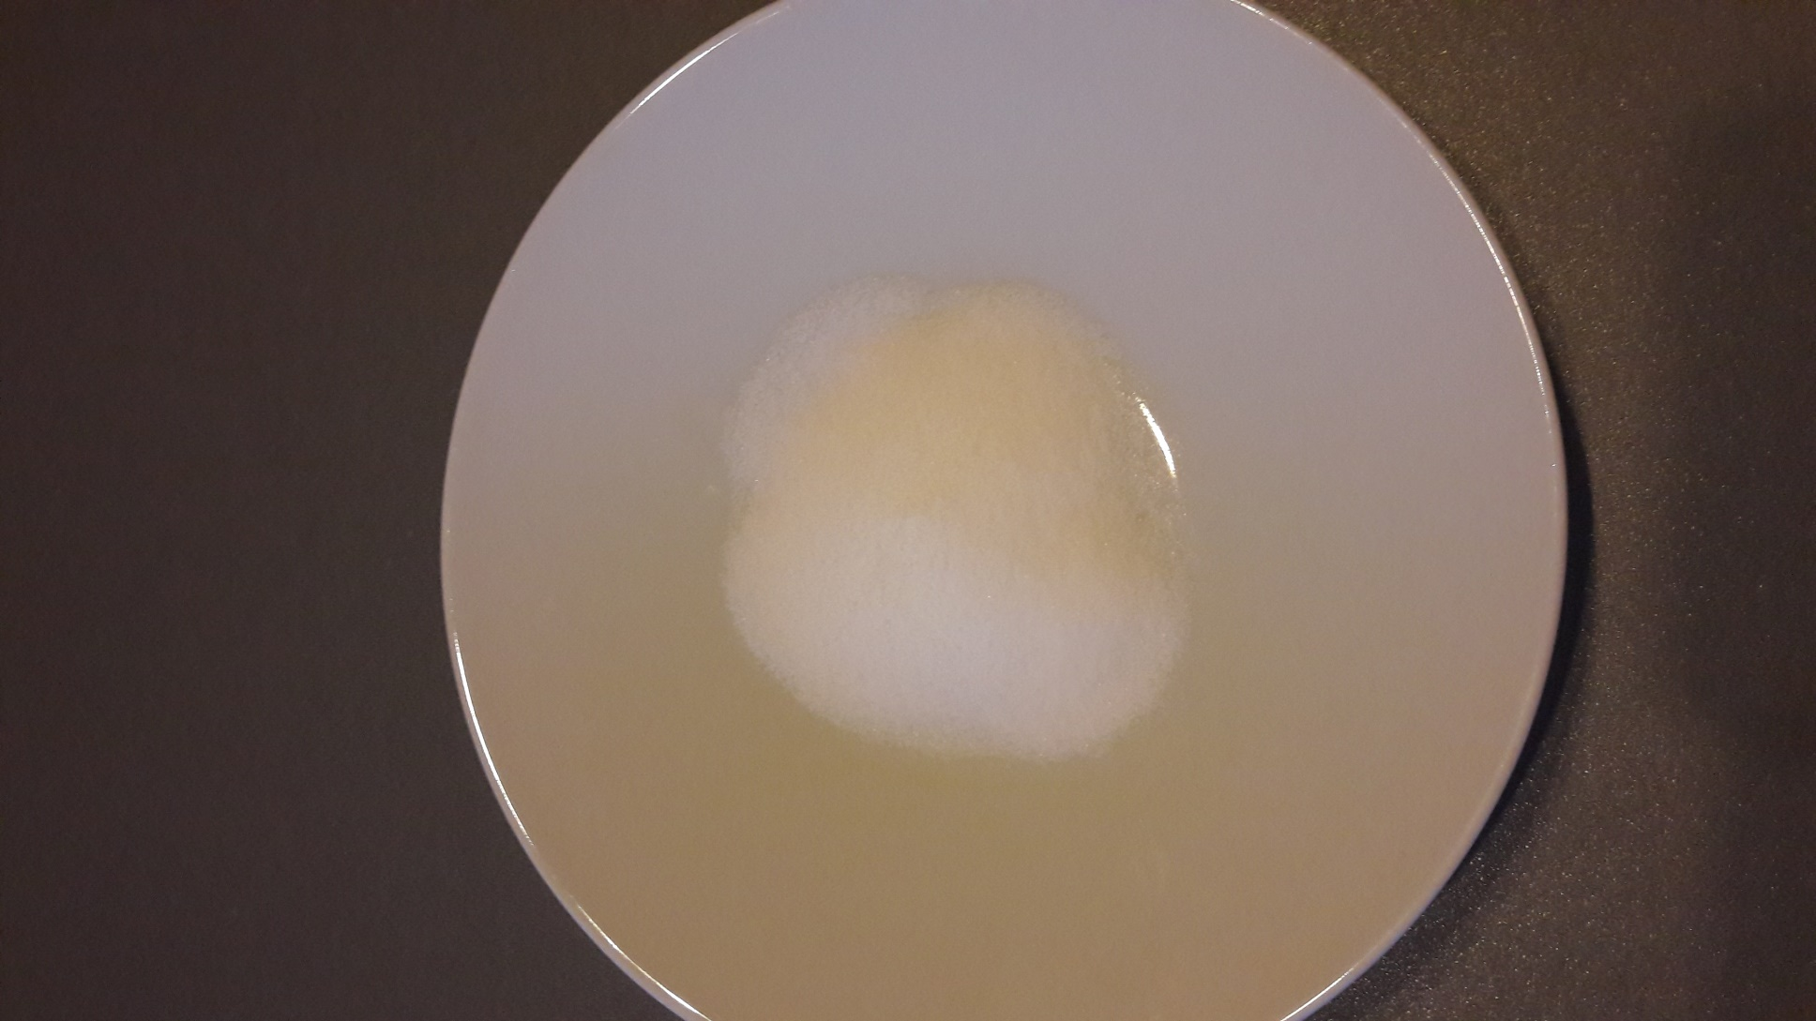
salt

Slide 17


Plickers exercises

Slide 18
andeja.zalik@guest.arnes.si
takeiteasy
Plickers exercises

Slide 19

a visual art related to writing
The principal tools for a calligrapher are the pen and the brush

Slide 20

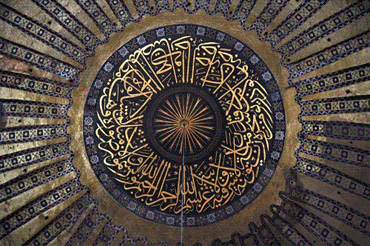

Example of islamic calligraphy
Hagia Sophia, Istanbul

Slide 21
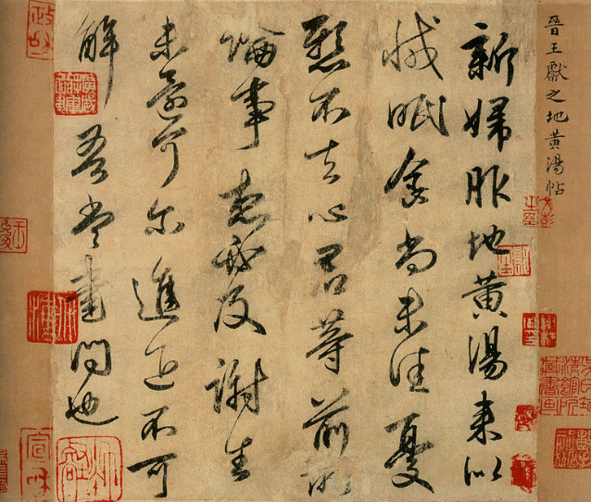
Example of Chinese calligraphy
Wang Xianzhi
344 AD

Slide 22
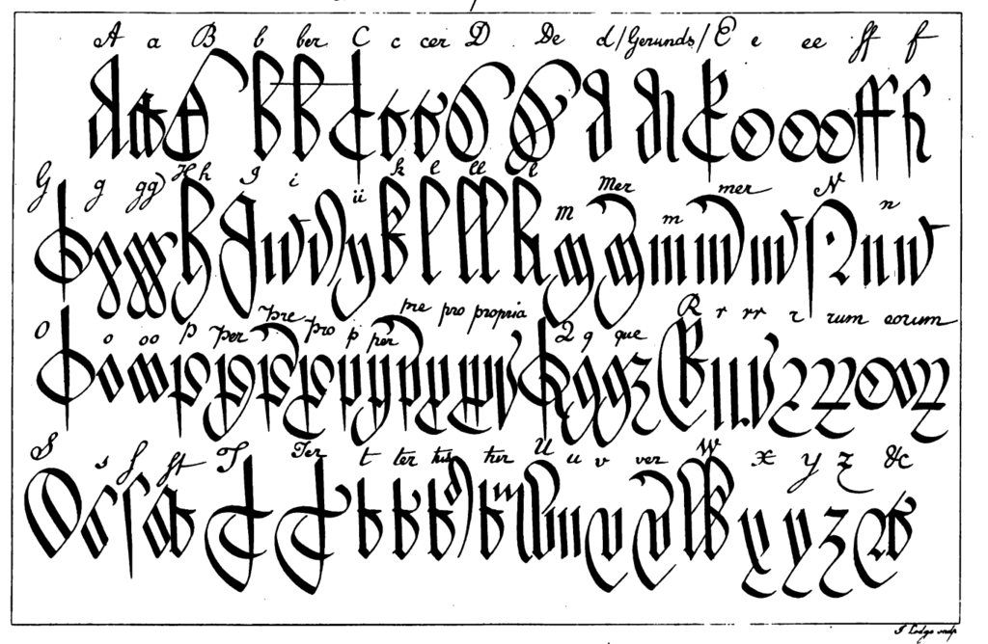
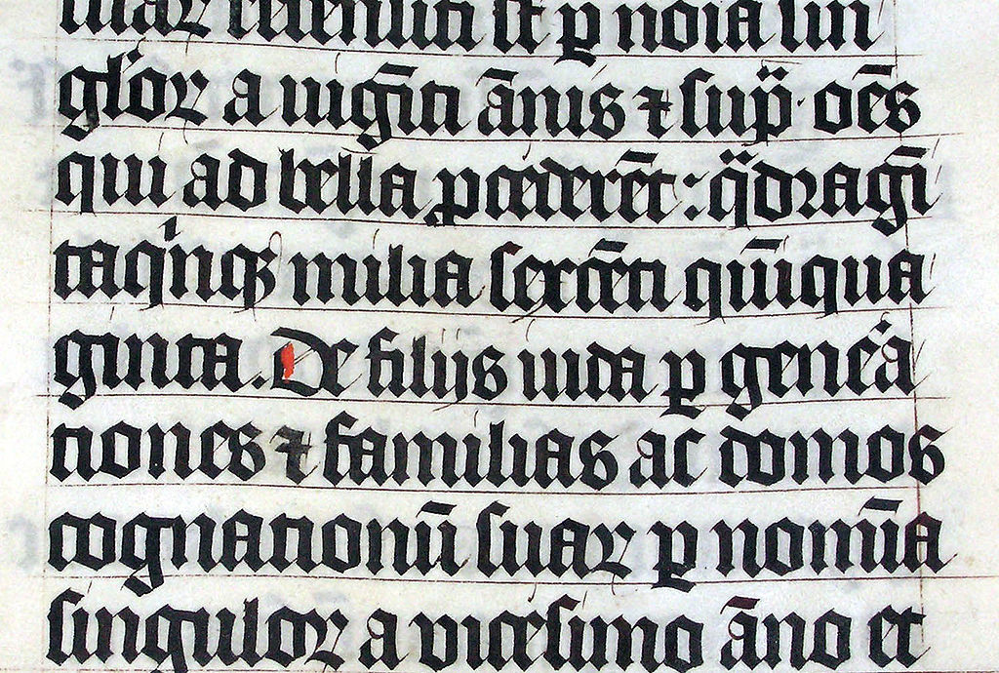
Examples of European calligraphy
Bible
AD 1407
Gothic
font

Slide 23
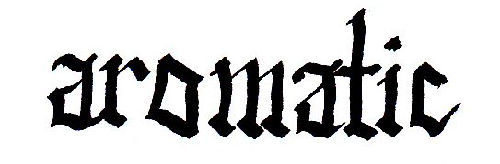
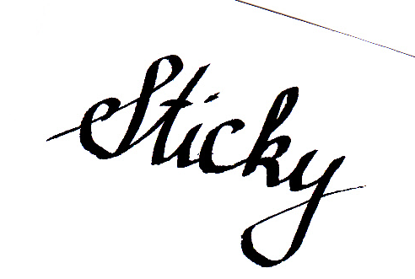
Gothic font
Square letters
slow
Italic font
Rounded letters
faster

Slide 24
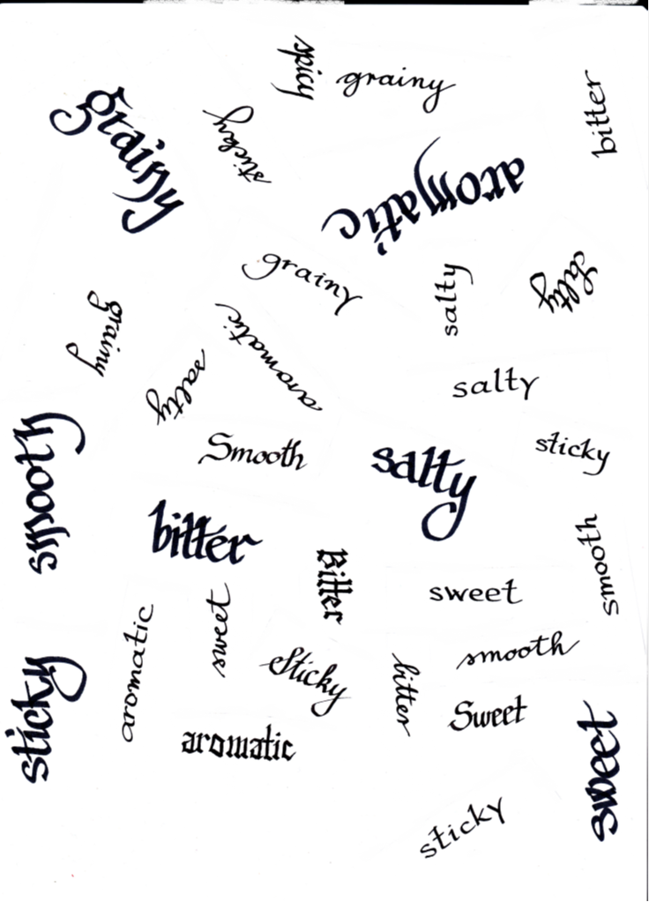
Handout ex. 4
Be a calligrapher
On your handout select one font and practice it on the paper.
When you master it, you will write on the gingerbread biscuit.
Be careful. You only have one go.
Good luck.

Slide 25
Thank you
I hope you have enjoyed the lesson.

