Slide 1
Dialog

Slide 2
patterns
Polonca Kolbl Ivajnšič

Slide 3
What is a pattern?

Slide 4
circle pattern
empty ful

Slide 5
spiral pattern

Slide 6
striped pattern

Slide 7
cracks pattern

Slide 8
wavy pattern

Slide 9
alphabet pattern
DEAR DEAR
I feel great! I feel great!

Slide 10
flower pattern

Slide 11
animal pattern
animal pattern
animal skin pattern

Slide 12
zigzag pattern

Slide 13
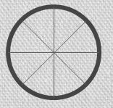
wheel pattern
bike wheel pattern
car wheel pattern

Slide 14
circle pattern
alphabet pattern
DEAR DEAR
spiral pattern
animal pattern
striped pattern
zigzag pattern
cracks pattern
flower pattern
wavy pattern
wheel pattern

