Slide 1
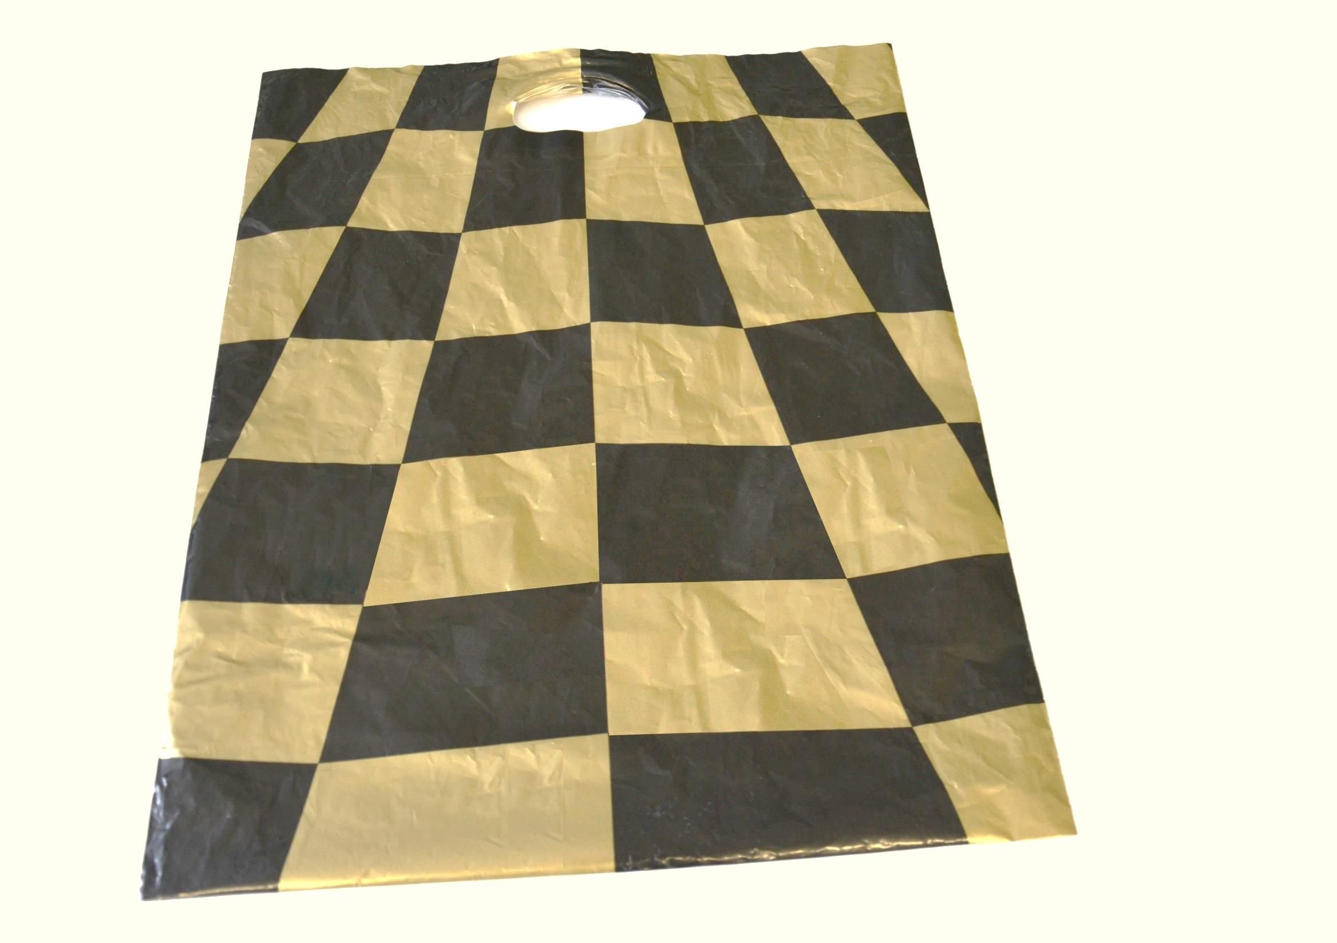
Shoping bag with black
and gold squares.

Slide 2
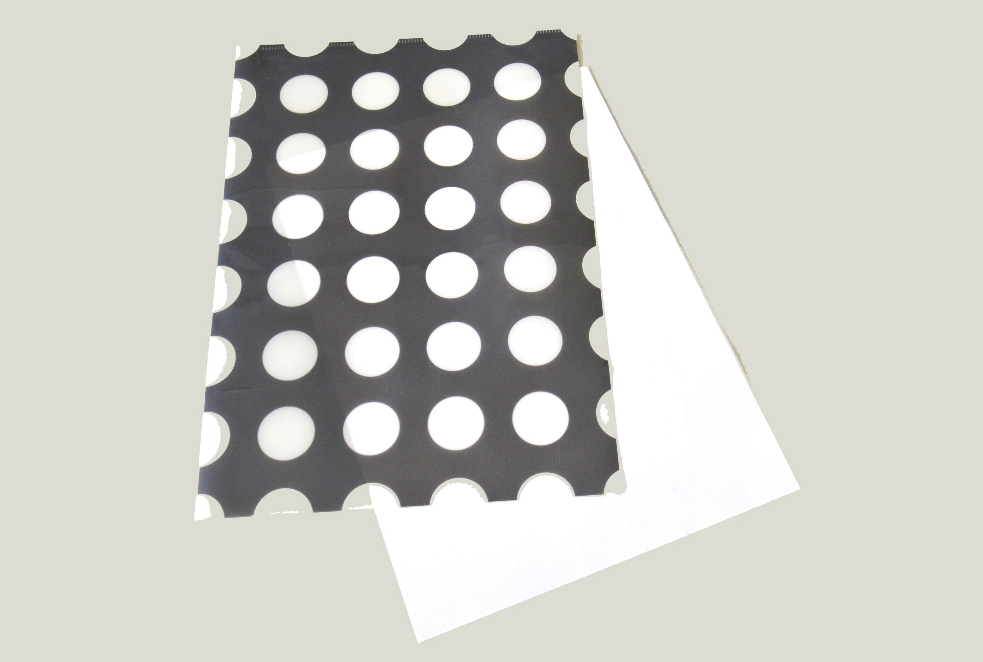
Folder with
dotted
pattern.

Slide 3
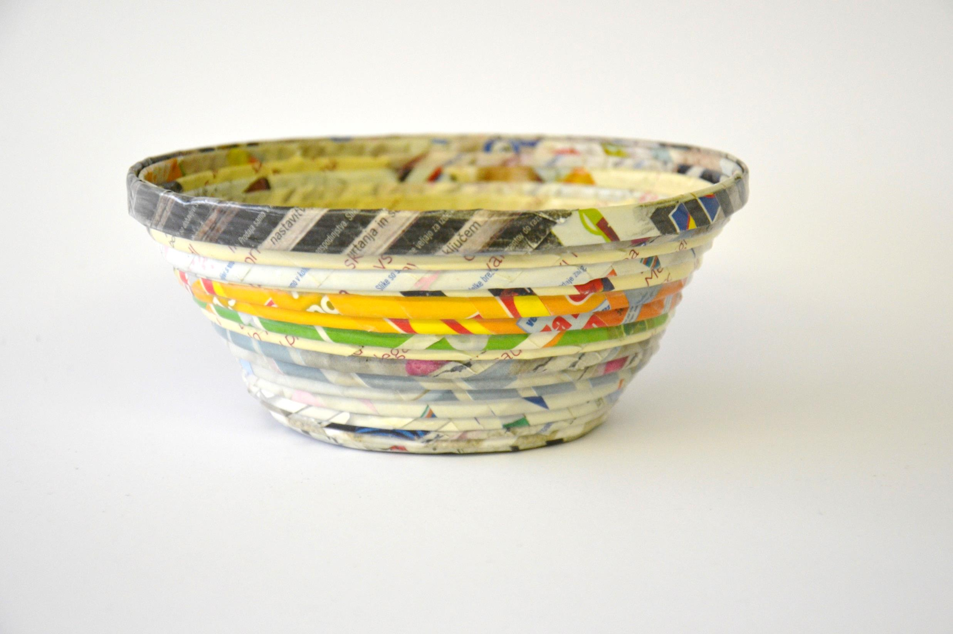
Paper bowl with
colorful stripes.

Slide 4
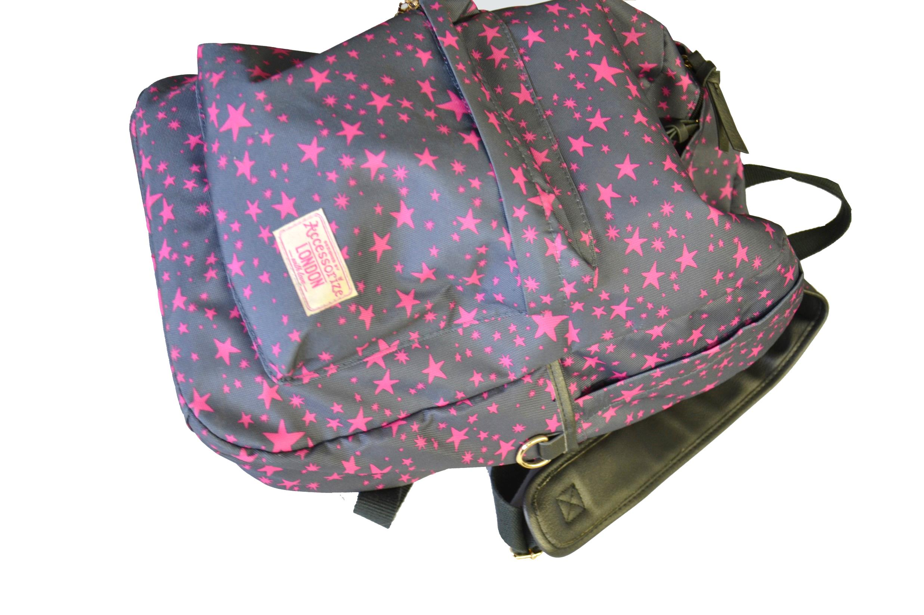
Grey backpack with
pink stars.

Slide 5
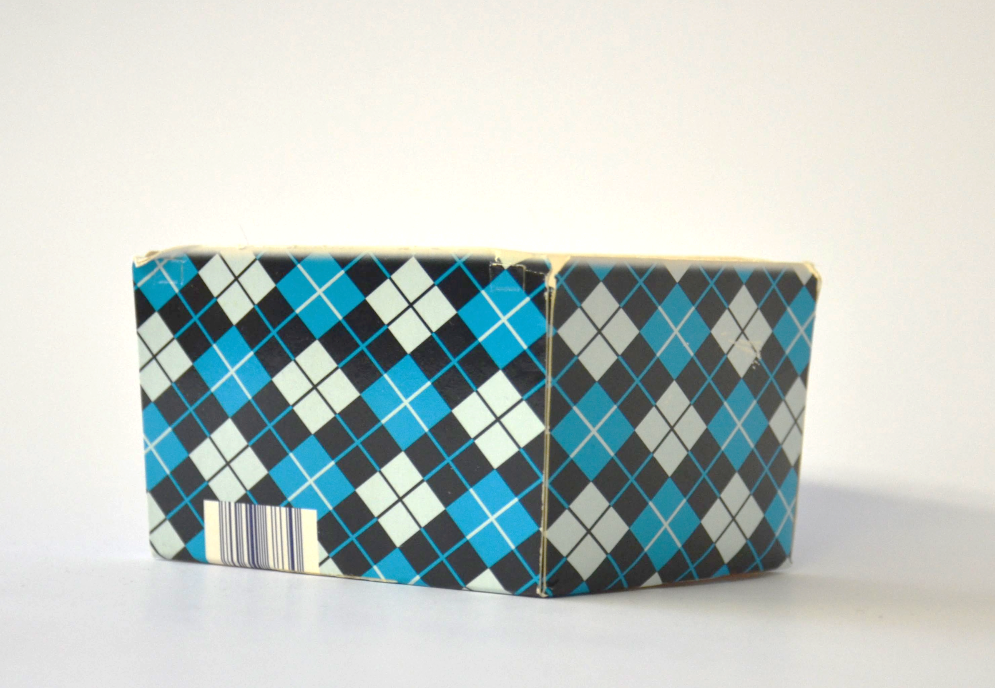
Carton box with
blue and black
checkered/diamond
pattern.

Slide 6
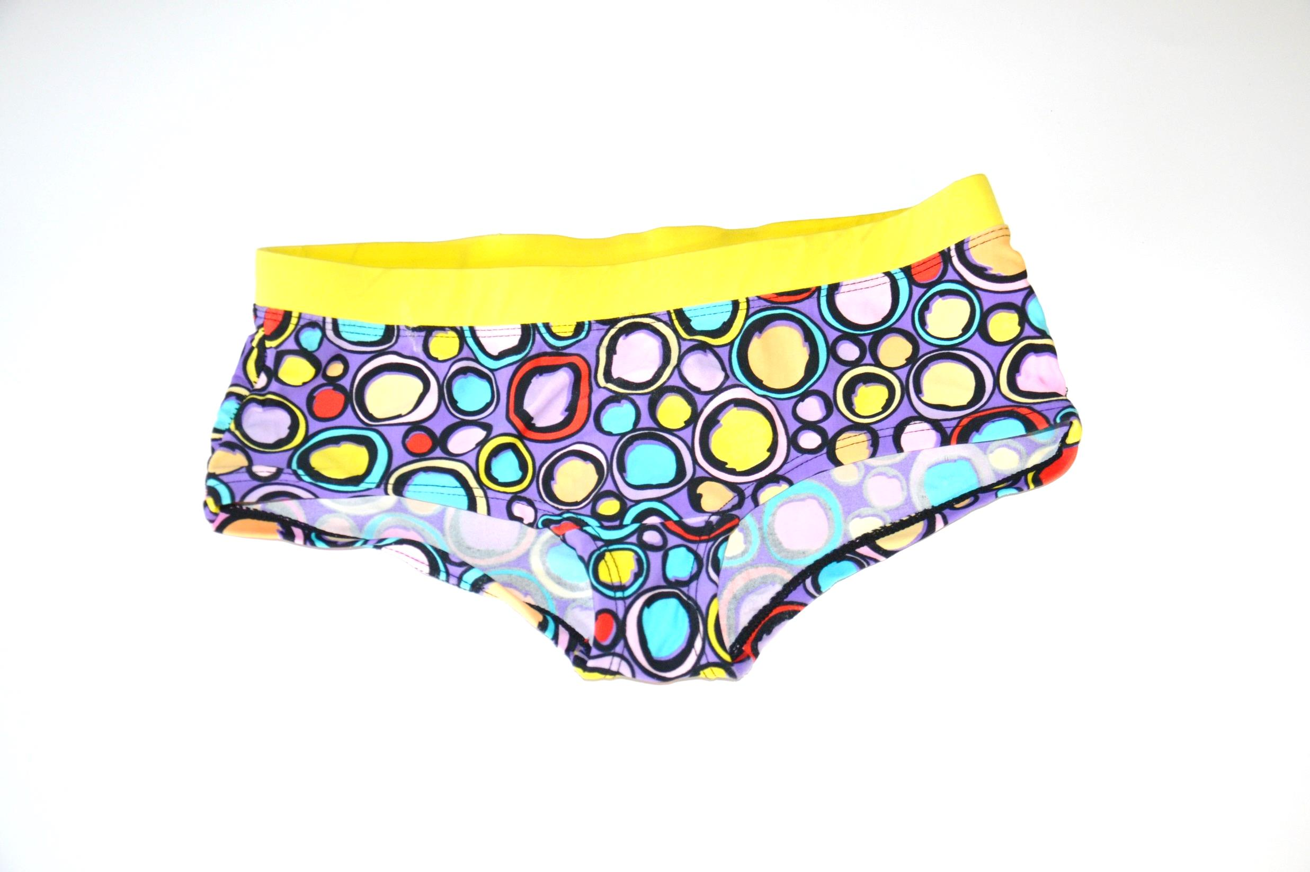
Swimsuit with
colorful circles.

Slide 7
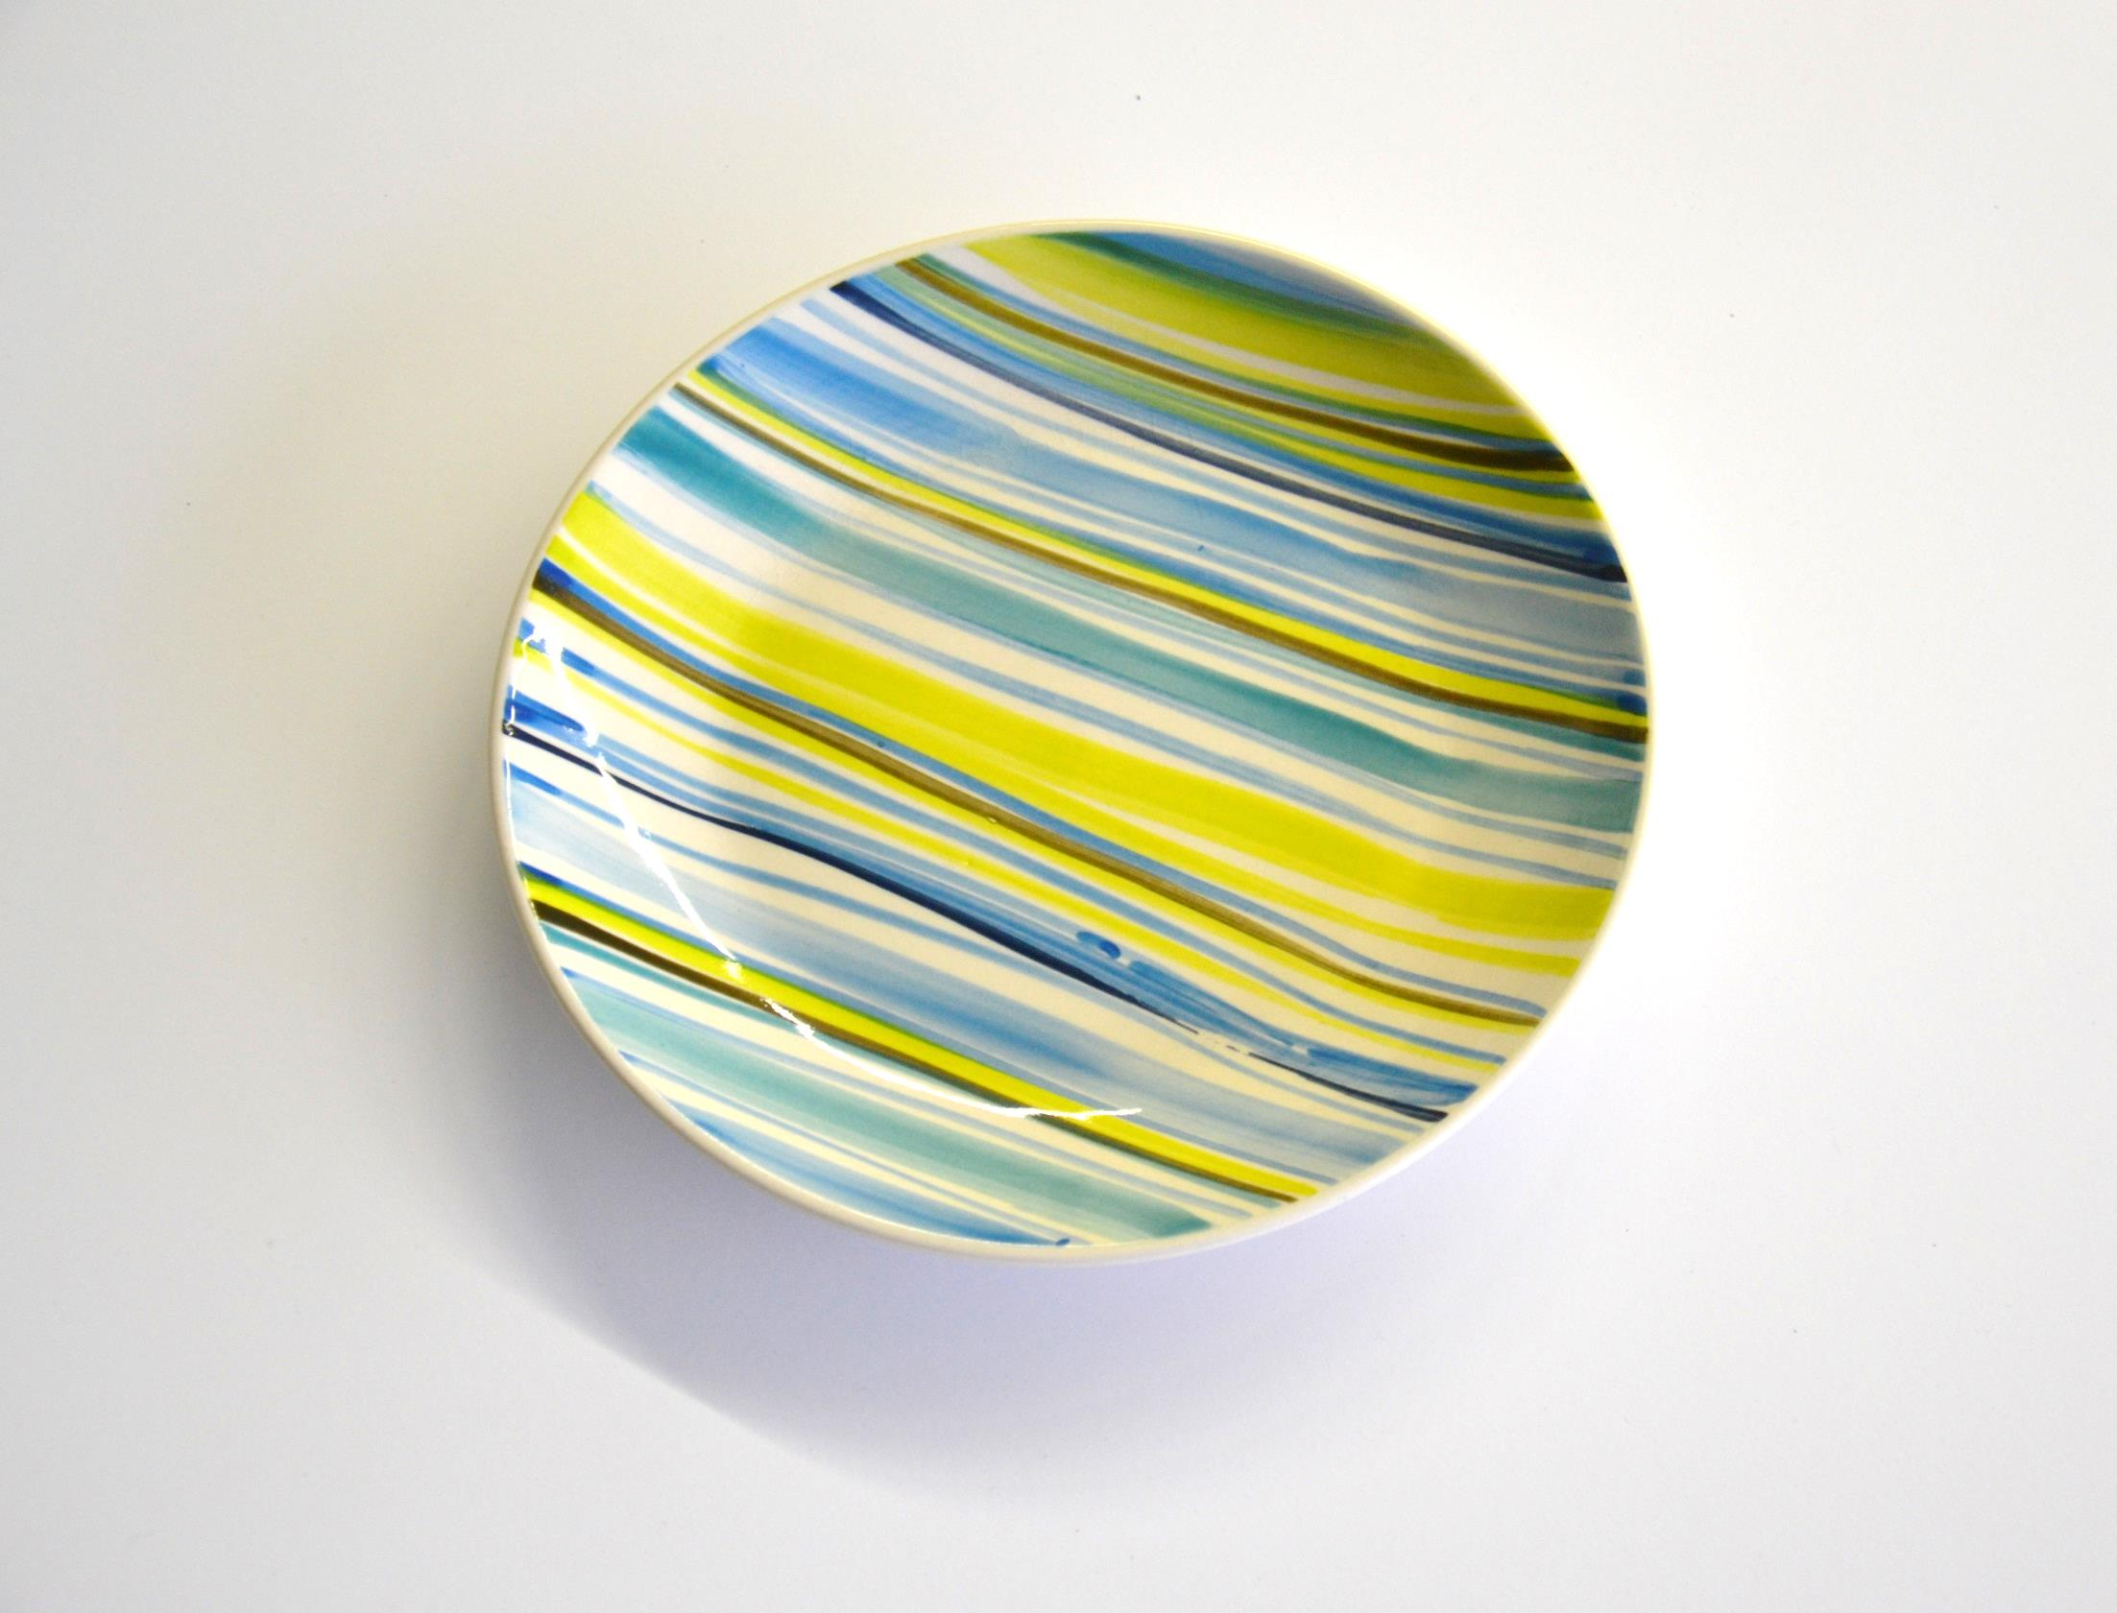
Plate with
blue, green, black and
white stripes pattern.

Slide 8
Blue wall painting with waves pattern.

Slide 9
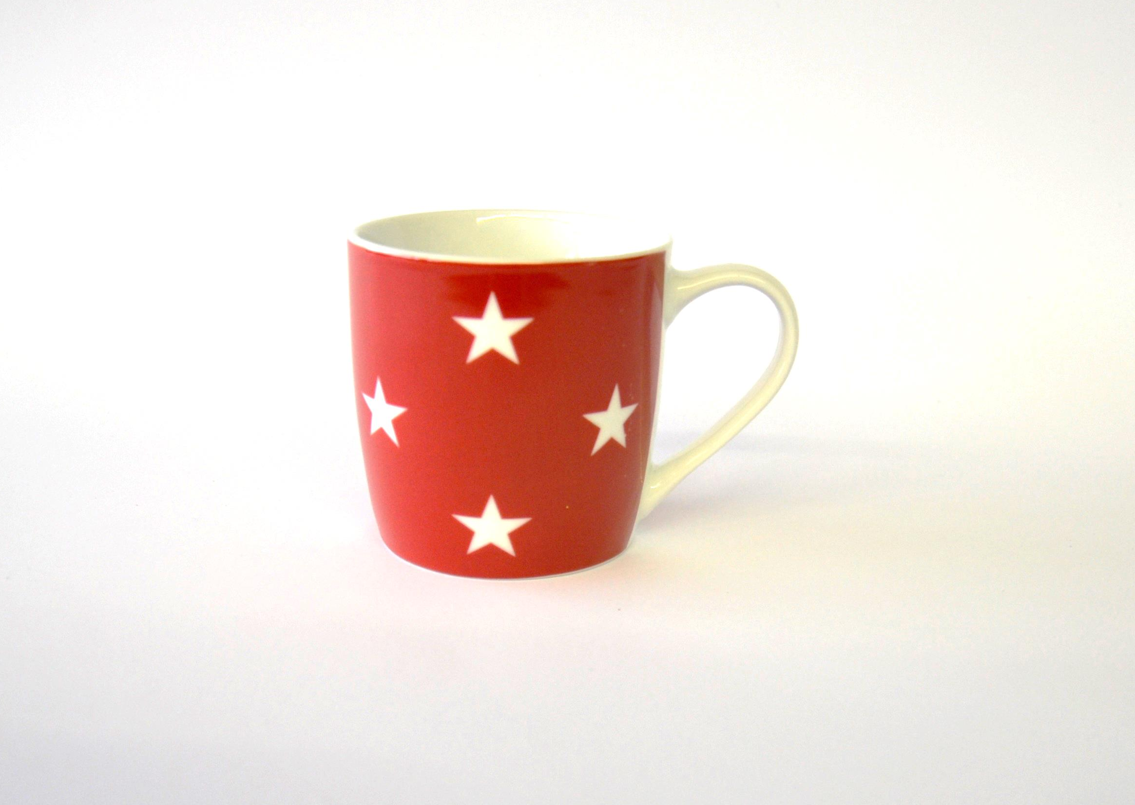
Red coffee cup with
white stars.

Slide 10
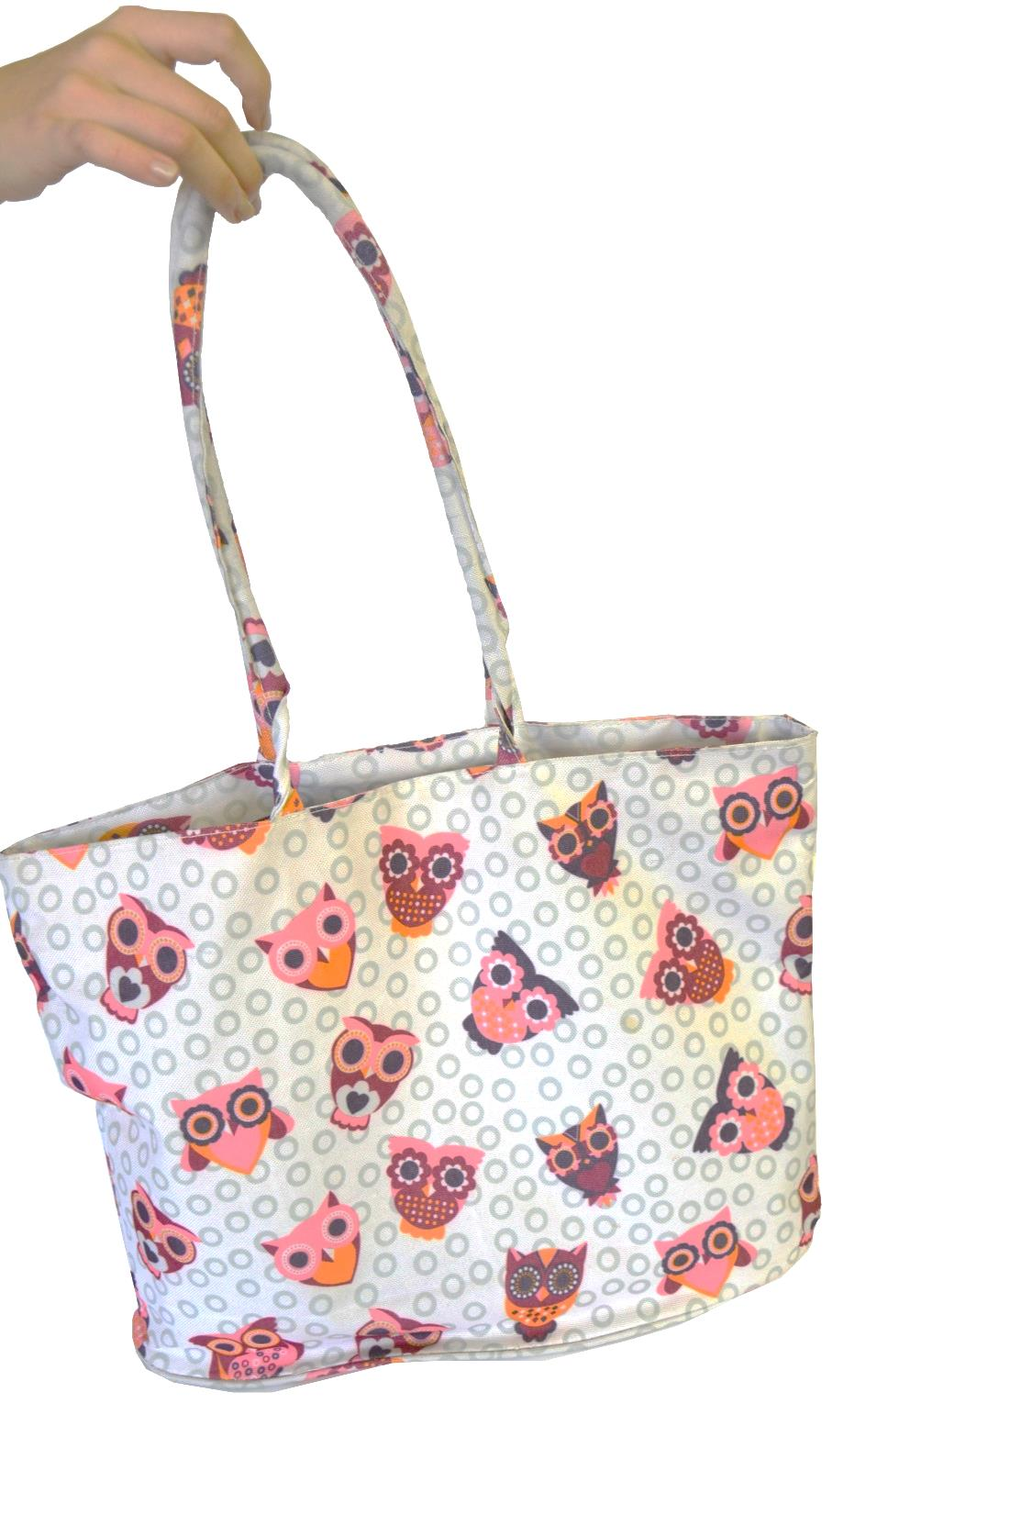
Gray dotted bag with
owls.

Slide 11
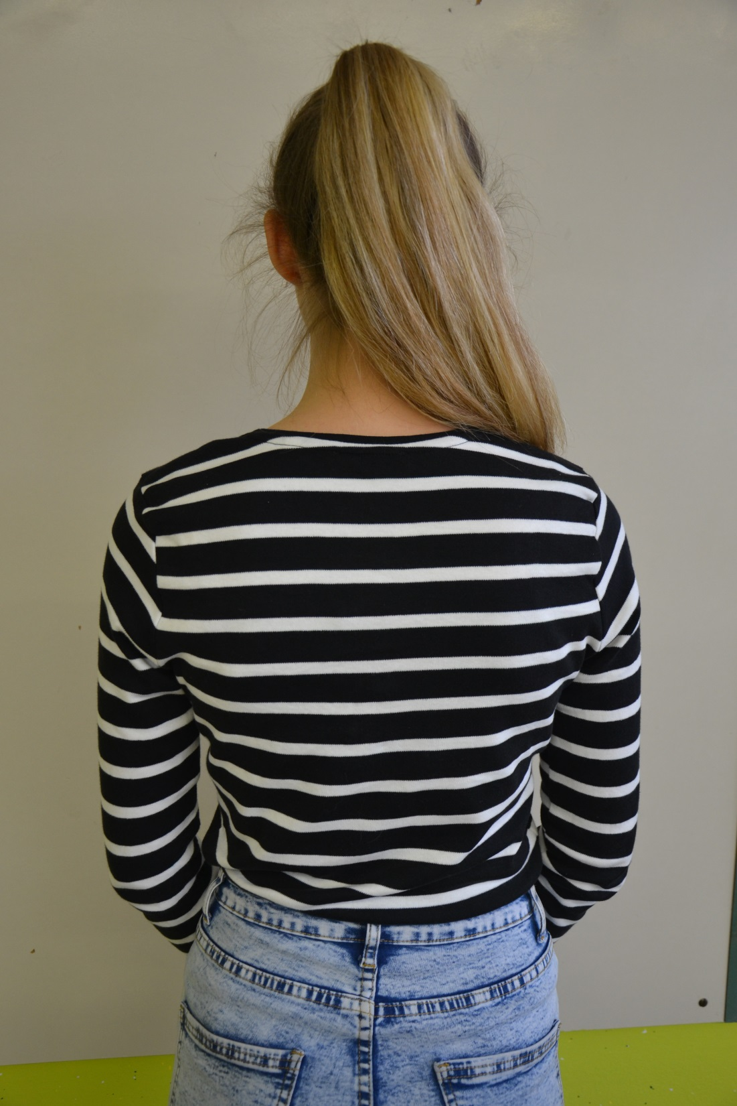
Black shirt with
white stripes.

Slide 12
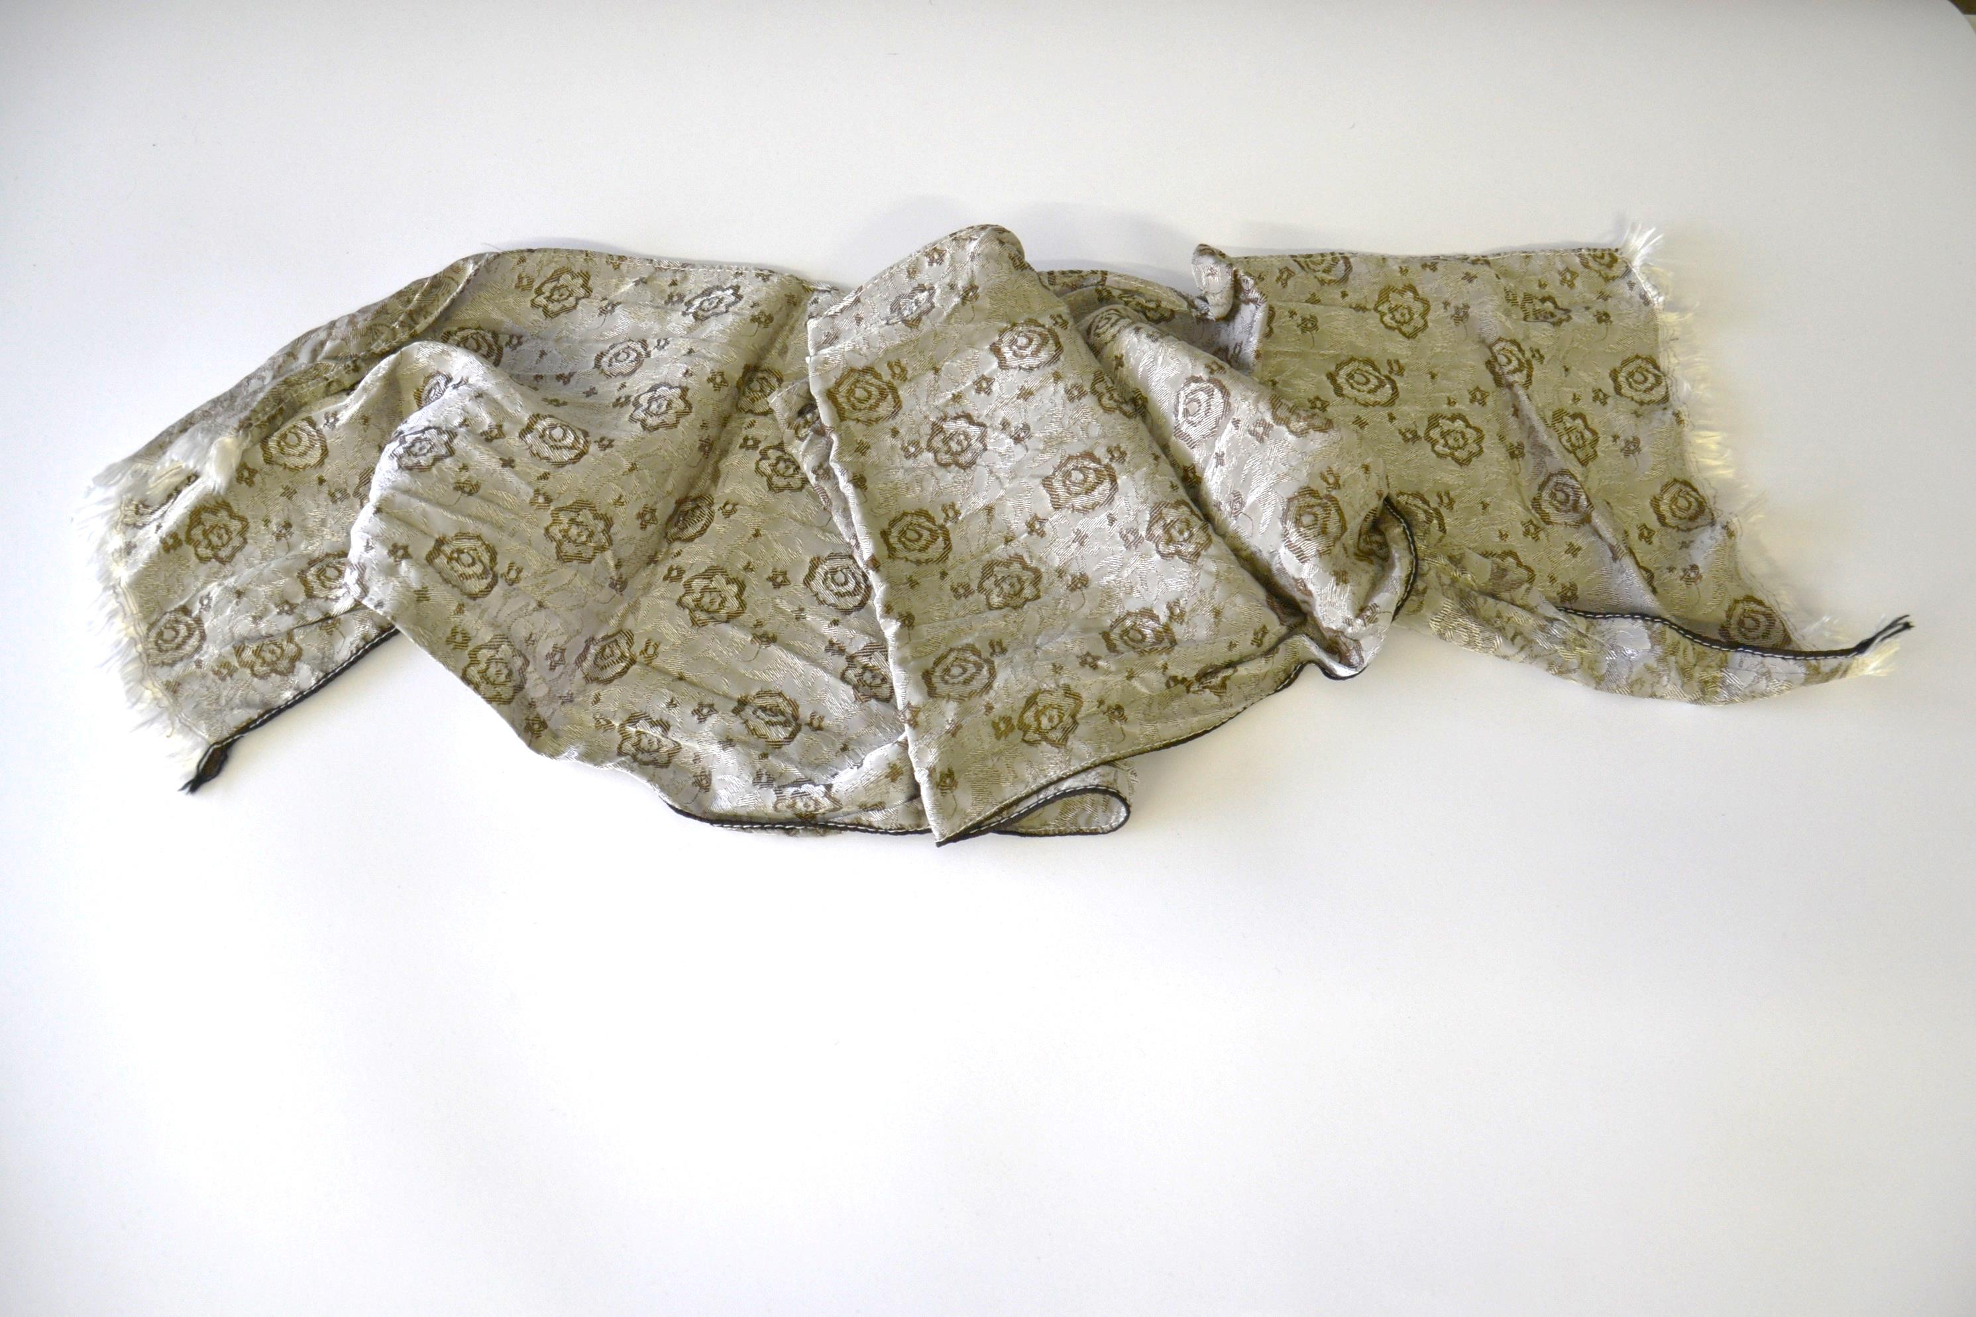
Silk scarf with small flowers.

Slide 13
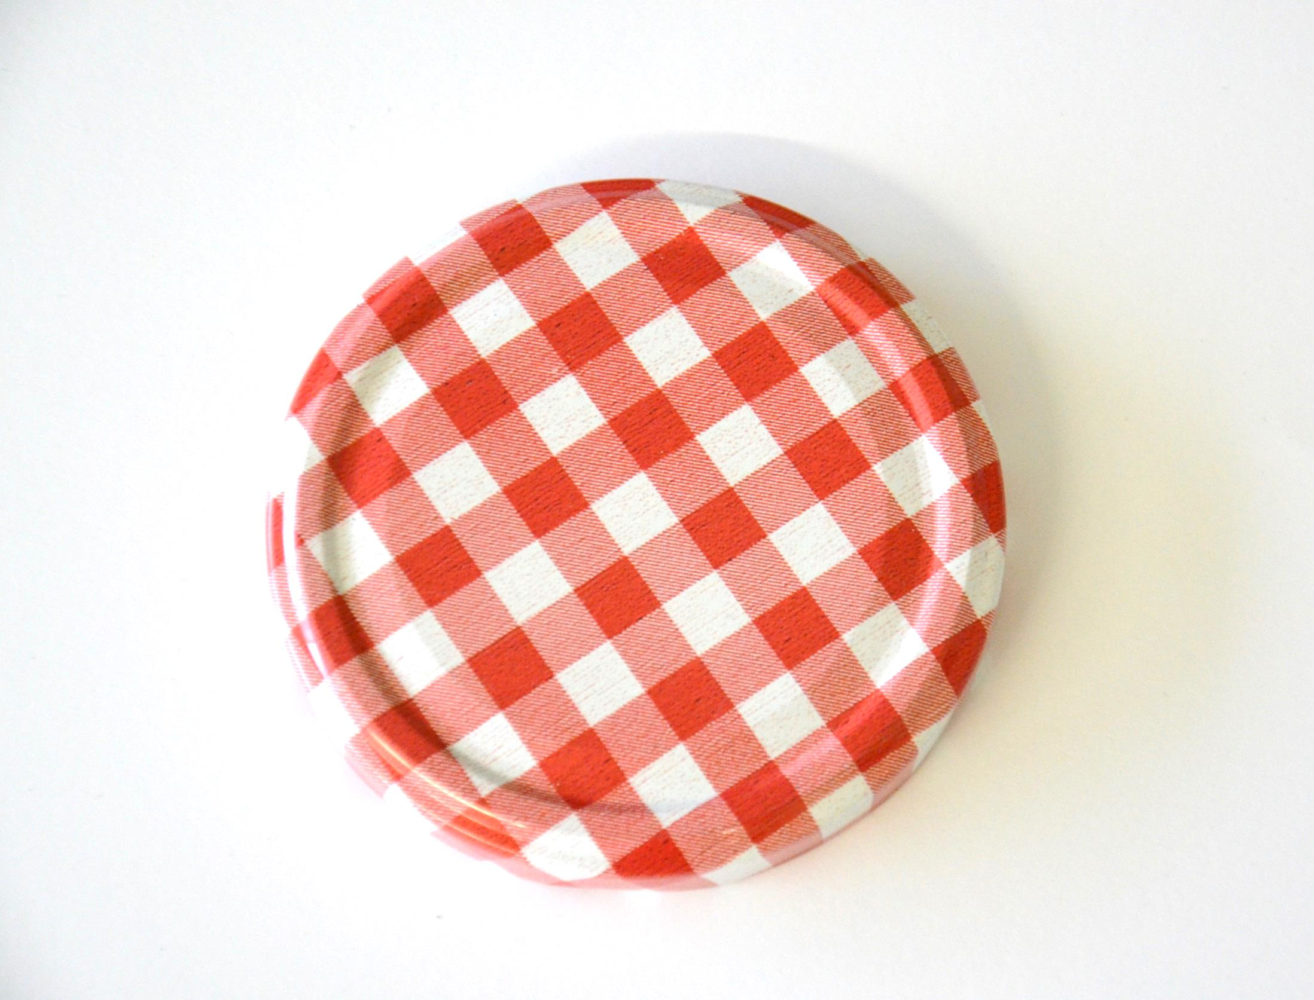
Jar cover with red
checkered/diamond
pattern.

Slide 14
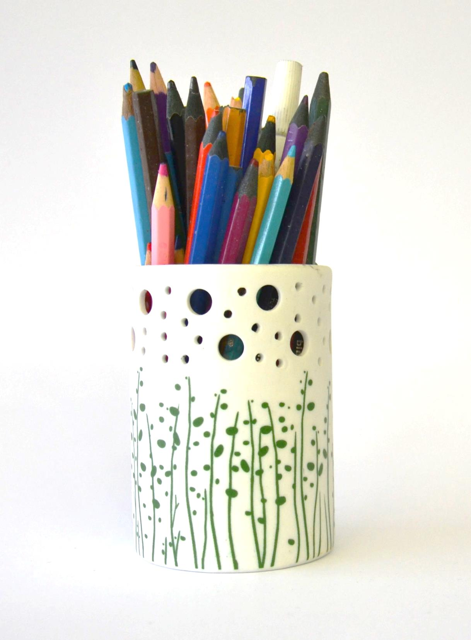
Crayons holder with
grass pattern.

Slide 15
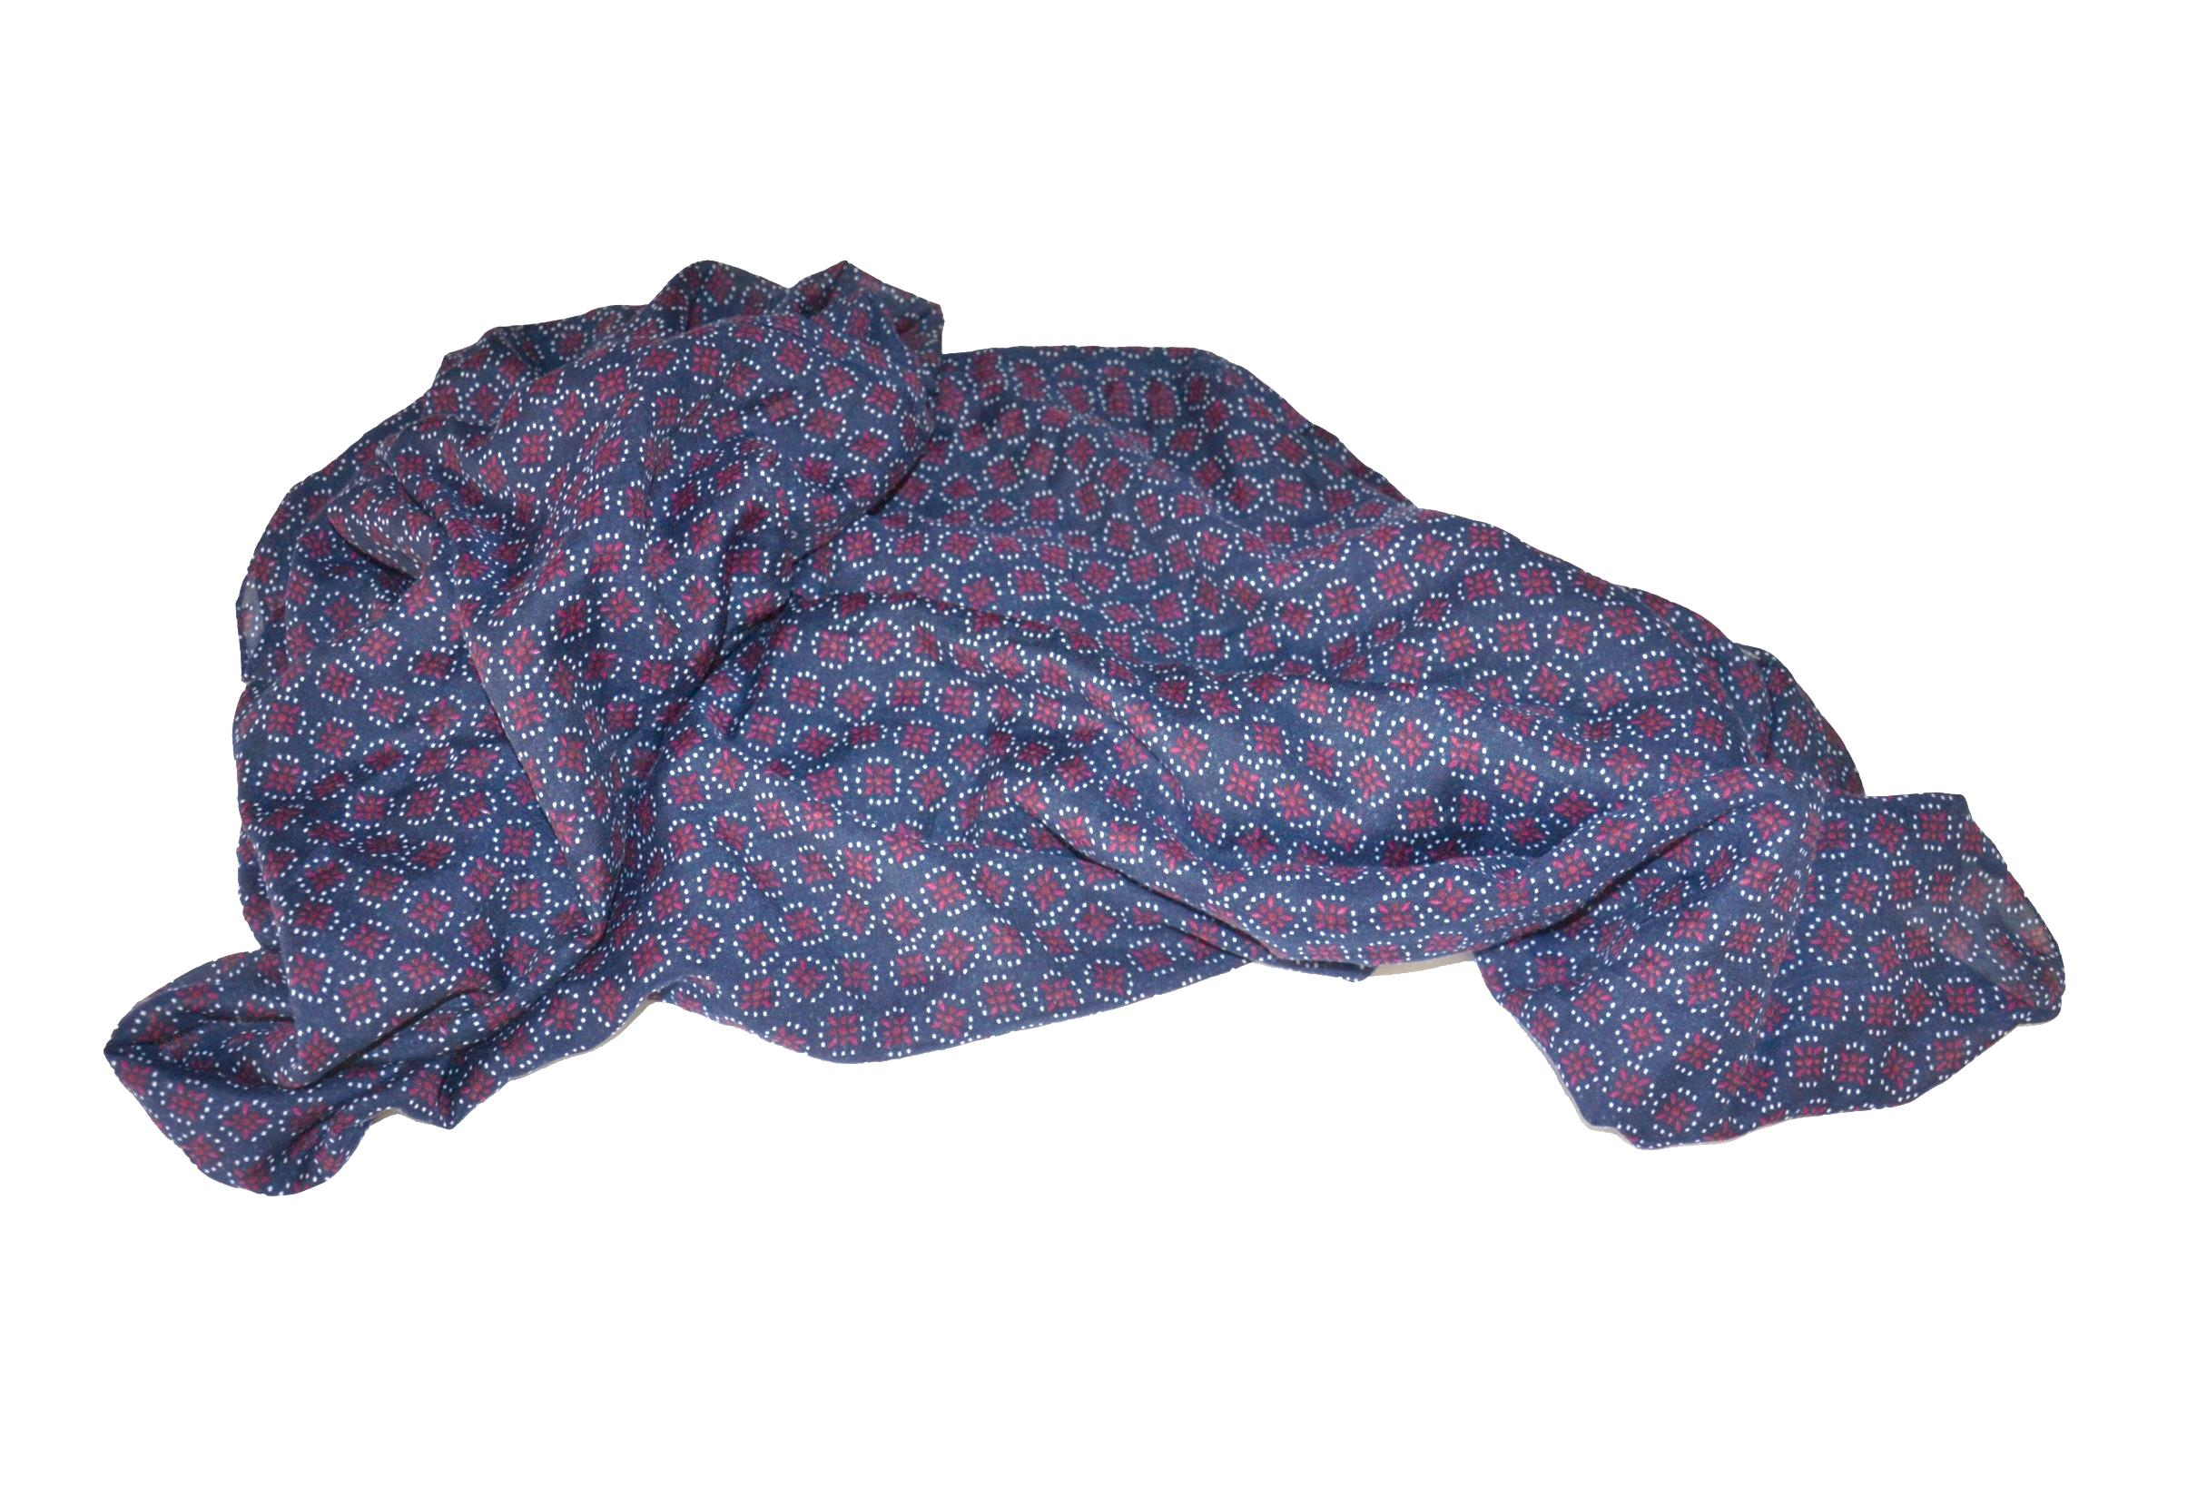
Blue scarf with small dots.

Slide 16
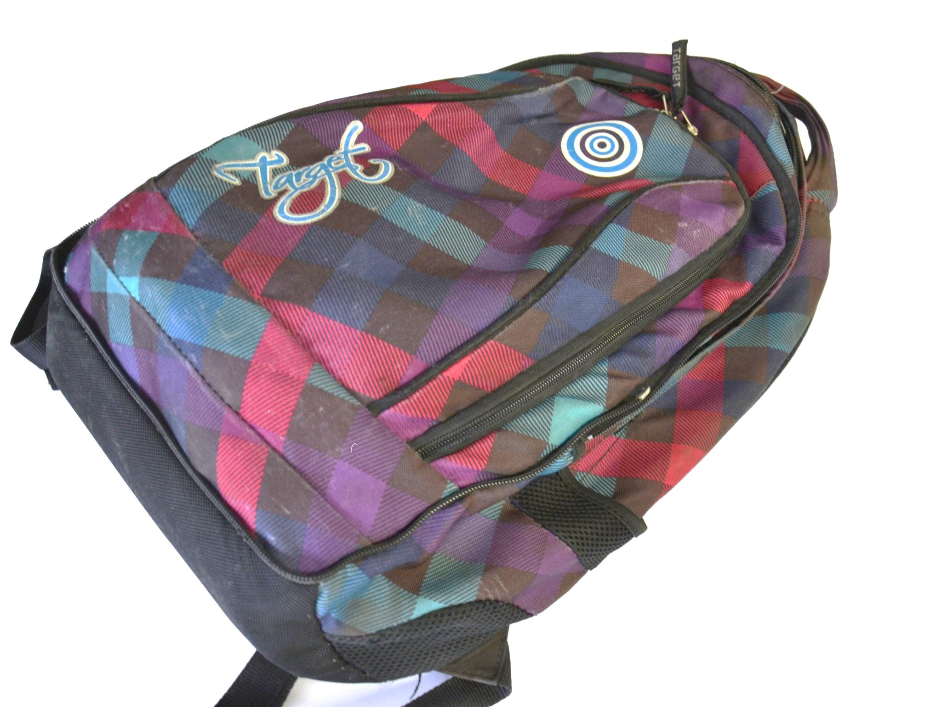
Colorful backpack with
lines.

Slide 17
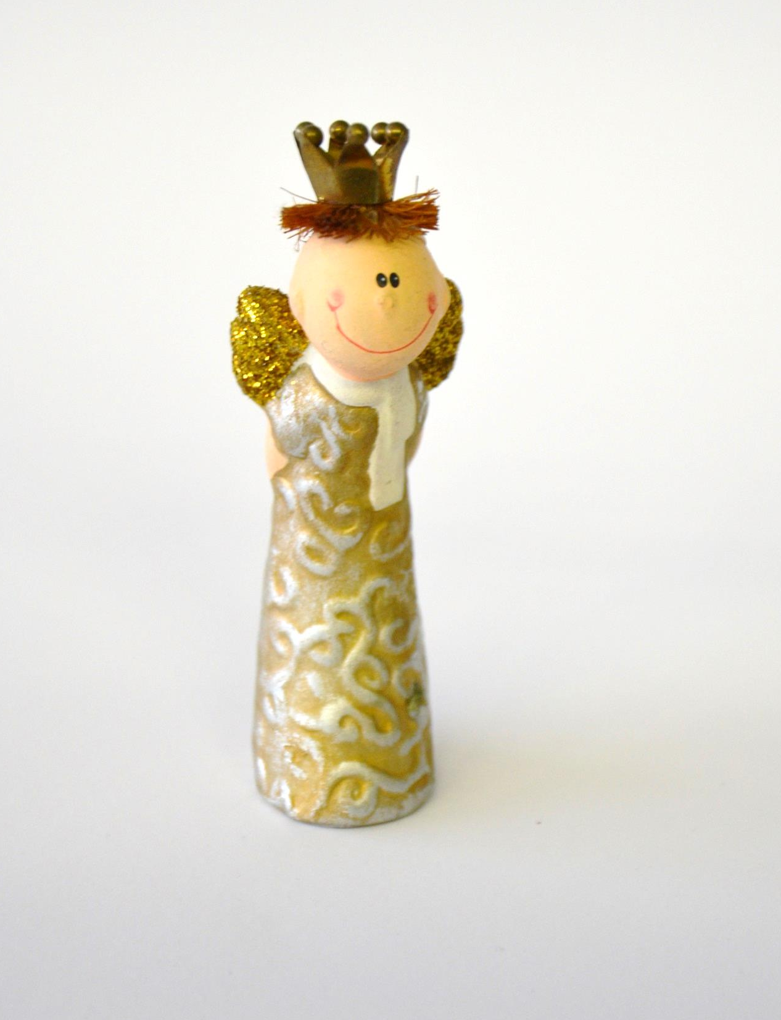
Little angel with spiral patern .

Slide 18
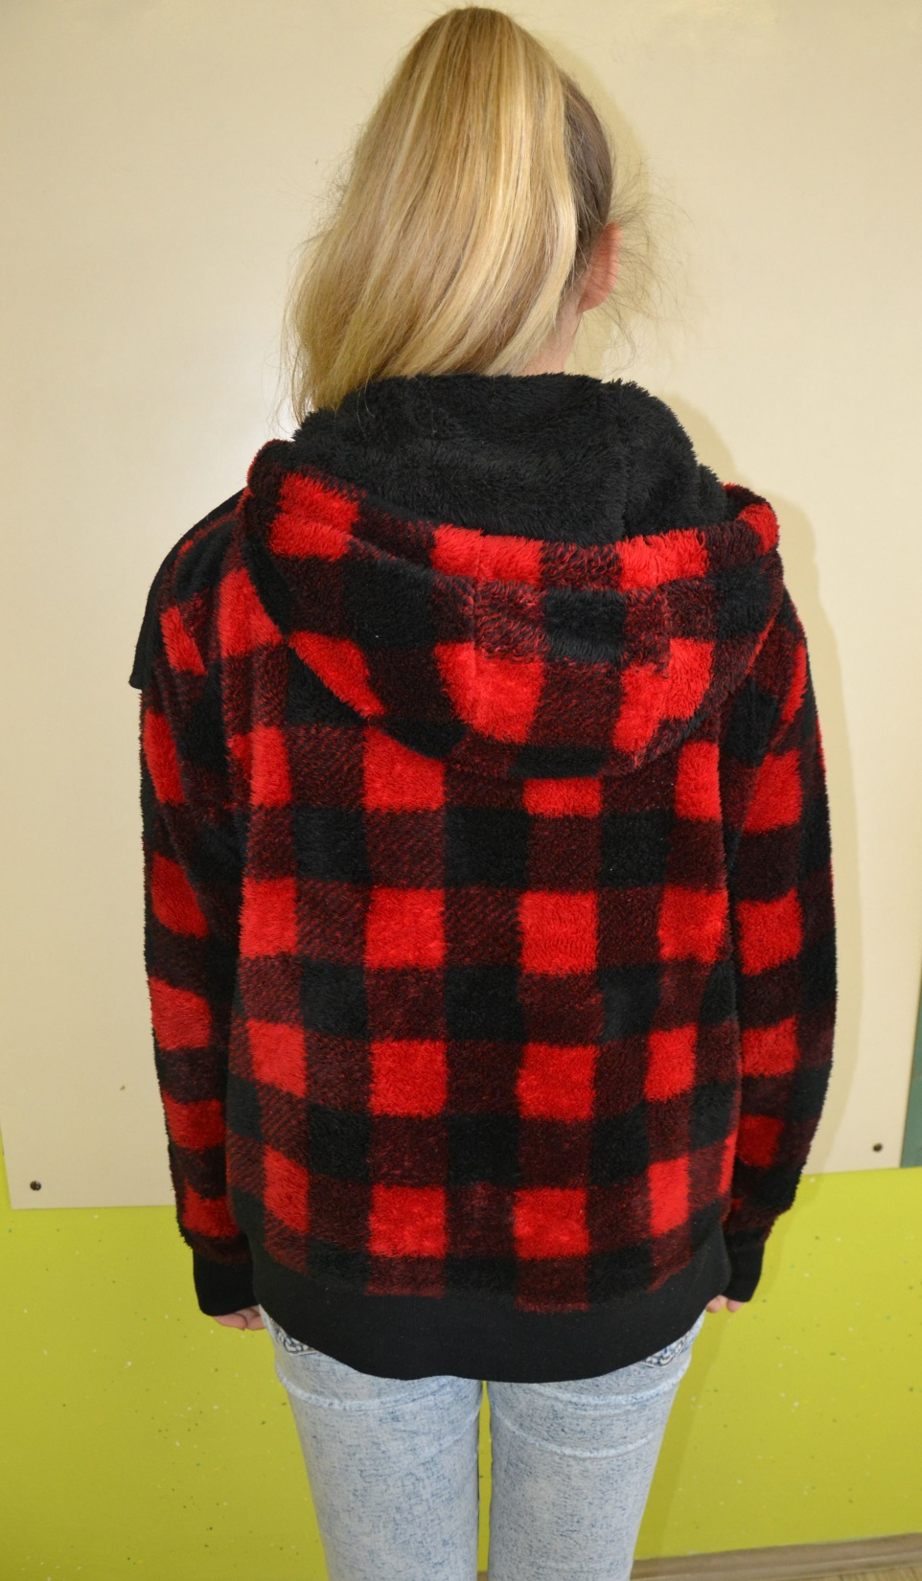
Sweatshirt with black and
red squares .

Slide 19
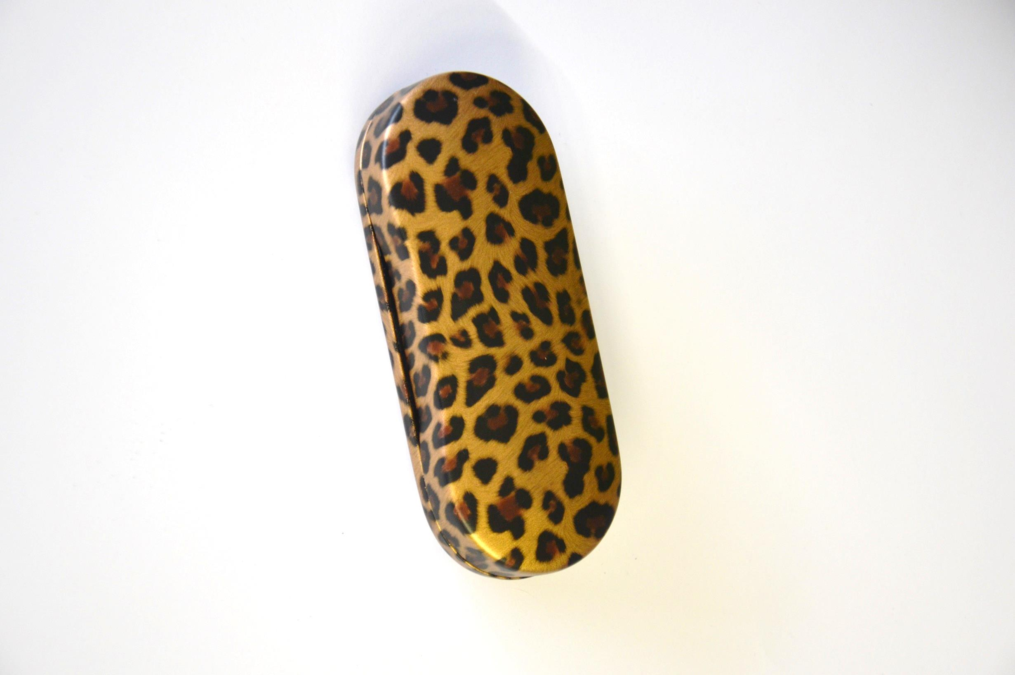
Case for glasses with animal pattern.

Slide 20
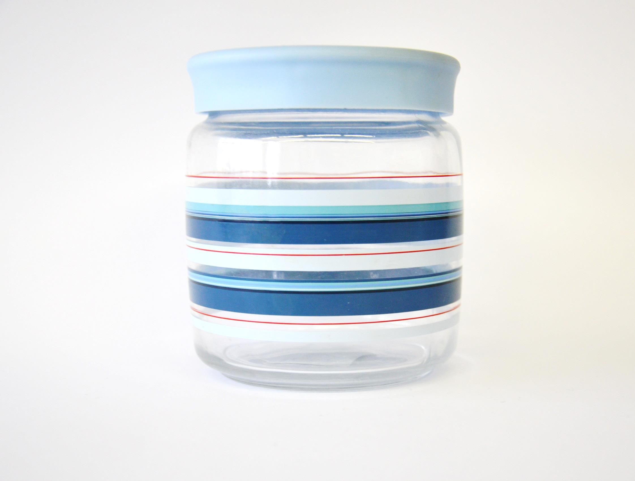
Jar with colorful lines.

